Slide 1


Artificial Intelligence as a Research Tool in Solar Module Reliability Analysis
By Rahul Kumar
Notes:
---

Slide 2
Artificial Intelligence as a Research Tool in Solar Module Reliability Analysis
Notes:
Title Slide, Introduction, Background & Related Work, IEC vs AI Testing, AI in Accelerated Testing, Power Degradation Prediction, Workflow, ESG Impact, Conclusion

Slide 3
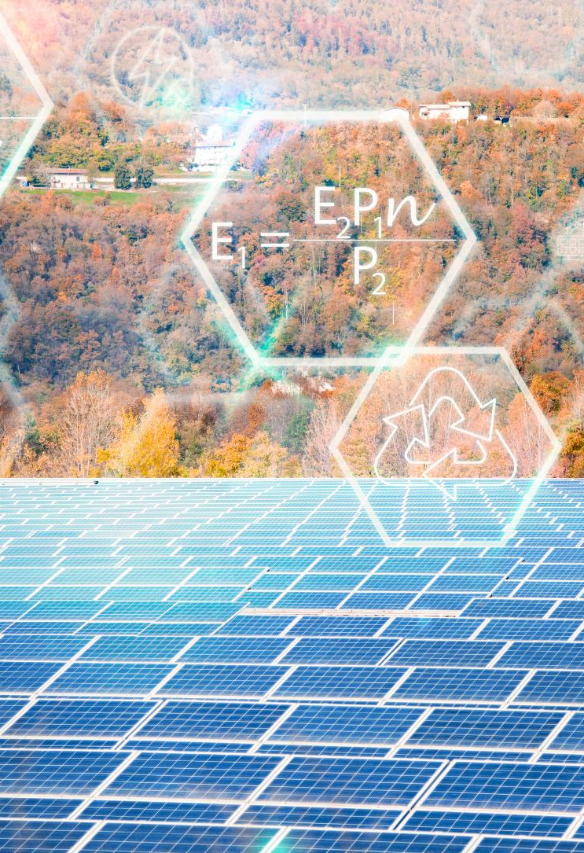
Title Slide
Research Context
  Solar modules are designed to last 25–30 years despite environmental and operational stresses.
Traditional vs AI Methods
  The study compares IEC-based reliability assessments with AI-driven predictive maintenance approaches.
Research Purpose
  Focus on AI to improve degradation modeling and failure detection in solar module reliability.
Presentation Tone
  The slide sets a formal academic tone, preparing for data-driven insights and detailed analysis.
Notes:
This slide introduces the presentation titled “Artificial Intelligence as a Research Tool in Solar Module Reliability Analysis,” authored by Rahul Kumar from Vikrant University Gwalior. It establishes the context of the research, highlighting how solar photovoltaic modules are expected to function reliably for up to 25–30 years while facing multiple environmental and operational stress factors. This title frame sets the stage for discussing the evolution from traditional IEC-based reliability assessment methods to modern AI-driven approaches that enable predictive maintenance, improved degradation modeling, and enhanced failure detection. By providing the research title and author credentials, the slide orients the audience toward the academic and technical depth of the topic. The title also cues the conference-style tone of the presentation, preparing the audience for a structured analysis, data-driven insights, and diagram-supported explanations that follow.

Slide 4

Introduction
Environmental and Mechanical Stressors
  Photovoltaic modules face temperature cycling, humidity, UV exposure, mechanical loads, and bias-induced stresses during their lifespan.
Limitations of Traditional Testing
  Current IEC testing protocols use single or sequential stress tests that fail to mimic complex real-world stress interactions.
AI Enhancing Reliability
  Artificial Intelligence learns from multimodal data to predict failures early and model multi-stress interactions effectively.
Towards Predictive Maintenance
  Integrating AI enables transition from reactive diagnostics to predictive, mechanism-aware maintenance strategies.
Notes:
The introduction provides a foundational overview of the environmental, mechanical, electrical, and photonic stressors affecting photovoltaic modules throughout their 25–30 year operational life. These stressors include temperature cycling, humidity ingress, ultraviolet exposure, mechanical loading, and bias-induced stresses, all of which interact in nonlinear ways under real-world conditions. Traditional IEC 61215/61730 accelerated testing protocols rely on sequential or single-stress frameworks that often fail to replicate these coupled interactions, limiting their ability to predict long-term performance outcomes. Artificial Intelligence (AI) enhances reliability research by learning stress–response relationships directly from multimodal datasets, such as environmental profiles, IV curves, EL/IR imaging, and material descriptors. This slide elaborates on how AI enables early failure prediction, multi-stress interaction modeling, and time-compressed test designs, thereby improving the correlation between accelerated testing and real-world degradation. It also introduces the motivation behind integrating AI into reliability workflows to transition from reactive diagnostics to predictive, mechanism-aware maintenance strategies.

Slide 5
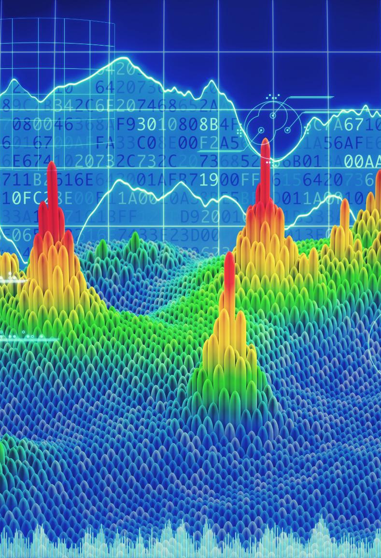
Background & Related Work
Multimodal Dataset Importance
  Combining IV curves, thermal images, electroluminescence scans, and environmental logs enhances photovoltaic predictive modeling accuracy.
Challenges in Fault Datasets
  Limited publicly available labeled fault datasets restrict model generalization across climates and module architectures.
Machine Learning Models Used
  Random Forest, XGBoost, ANN, CNN, and LSTM models are prominent for regression, image, and time-series analysis in this field.
Institutional Dataset Contributions
  Programs like NREL’s C-AST provide high-quality datasets that improve machine learning training for reliability assessment.
Notes:
This section reviews the body of research on AI applications in photovoltaic system performance forecasting, reliability assessment, and fault detection. Several studies highlight the importance of multimodal datasets—including IV curves, thermal/infrared images, electroluminescence scans, and long-term environmental logs—in enabling accurate predictive modeling. A significant challenge noted in literature is the scarcity of publicly available labeled fault datasets, which limits generalization of machine learning models across climates, module architectures, and stress conditions. The slide also discusses the established role of ML models such as Random Forest, XGBoost, and Artificial Neural Networks for regression tasks, as well as Convolutional Neural Networks and LSTM architectures for image and time-series analysis. Institutional programs such as NREL’s C-AST (Combined Accelerated Stress Testing) offer high-quality datasets that improve training quality. By contextualizing existing research, the slide underscores the need for AI-driven reliability tools that account for both physical degradation mechanisms and observed performance behaviors across diverse datasets.

Slide 6

IEC vs AI Testing
IEC Testing Fundamentals
  IEC testing uses fixed stress protocols focusing on product qualification and safety compliance rather than detailed degradation analysis.
AI-Enabled Multistress Profiling
  AI testing supports simultaneous multistress profiling, reflecting real-world conditions and providing detailed degradation insights.
Early Degradation Detection
  AI combined with EL/IR imaging detects early signs like microcracks and solder fatigue before measurable power loss occurs.
Efficiency and Predictive Insights
  AI reduces test duration by 30–50% and offers continuous predictive outputs instead of simple pass/fail results.
Notes:
This slide presents a comparative analysis between traditional IEC-based reliability testing and AI-augmented accelerated testing. IEC frameworks rely on fixed, single-stressor or sequential-stressor protocols and aim primarily for qualification and safety compliance rather than detailed degradation modeling. In contrast, AI-based testing supports simultaneous multistress profiling that better reflects field conditions. AI enables early detection of microcracks, PID onset, solder fatigue, and encapsulant degradation using EL/IR imaging combined with machine learning. The content also highlights time-efficiency gains, where AI reduces overall test duration by 30–50% by identifying early signatures of degradation that precede measurable power loss. Additionally, AI-based methods offer continuous insight and predictive outputs—such as expected power-loss trajectories—rather than simple pass/fail results. This slide emphasizes that IEC testing qualifies products, whereas AI testing qualifies understanding by revealing root causes and providing real-time feedback for design improvement.

Slide 7

AI in Accelerated Testing
AI-Driven Stress Optimization
  AI optimizes environmental and electrical load sequences to accelerate degradation mechanisms efficiently.
Lab–Field Mapping with AI
  Supervised learning models correlate early lab signatures with long-term field performance for better predictions.
Early Failure Detection
  AI detects microcracks, delamination, and PID before power loss, enabling earlier design decisions.
Closed-Loop R&D Workflow
  AI feeds degradation predictions into R&D to rapidly improve module design and testing sequences.
Notes:
This slide explains the role of AI in creating intelligent, mechanism-aware accelerated testing frameworks for photovoltaic modules. AI-driven stress design allows optimization of environmental and electrical load sequences to accelerate specific degradation mechanisms more efficiently. Through lab–field mapping, supervised learning models correlate early laboratory signatures—such as EL pattern evolution, leakage current trends, or series resistance changes—with long-term field performance. This reduces reliance on fixed activation energy models and improves climate-specific lifetime estimations. Early failure recognition is emphasized, showing how AI detects microcracks, delamination, and PID before noticeable power loss occurs, enabling earlier decision-making in materials, lamination stack, and circuit design. The slide also covers closed-loop system design: AI continuously feeds degradation predictions back into R&D workflows, allowing rapid iteration in encapsulant selection (EVA/POE), module architecture, and test sequencing. This accelerates innovation toward reliability-aware module development.

Slide 8
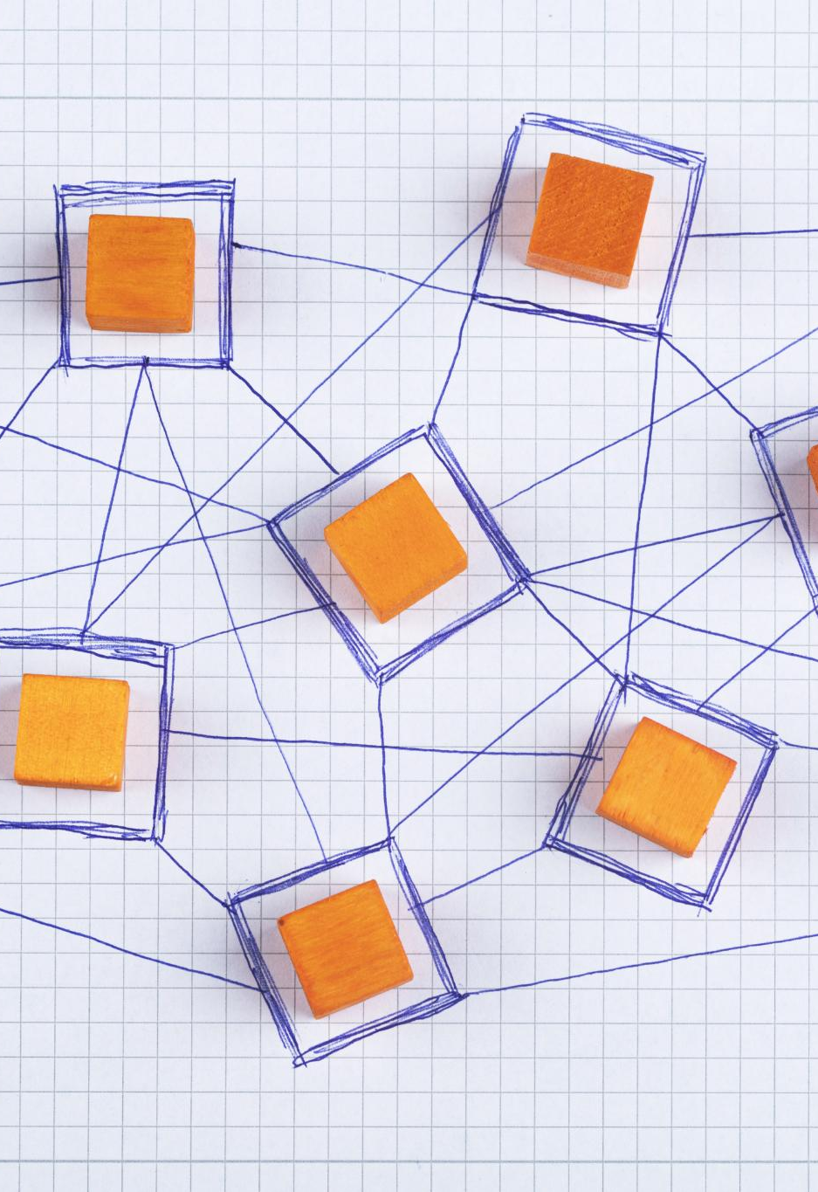
Power Degradation Prediction
Multidomain Input Features
  AI models use environmental, electrical, material, and image data to understand degradation in photovoltaic modules.
AI and Temporal Modeling
  Regression and temporal AI models capture nonlinear degradation patterns and seasonal variations effectively.
Physics-Informed Machine Learning
  Integrating physics principles like thermal degradation and moisture ingress enhances long-term degradation predictions.
Model Interpretability and Outputs
  Feature importance maps reveal degradation causes; predicted power loss and lifespan guide maintenance decisions.
Notes:
This section details how AI models predict power degradation in photovoltaic modules by processing multidomain input features such as environmental histories (temperature, humidity, UV exposure), electrical parameters (Voc, Isc, resistance values), material characteristics (encapsulant type, moisture barrier properties), and image-derived features from EL/IR scans. AI regression models—including Random Forest, ANN, and XGBoost—learn nonlinear relationships between stress histories and degradation pathways, while temporal models such as LSTMs and Transformers capture seasonal variations and dynamic behaviors that influence degradation rates. Physics-informed machine learning approaches integrate principles from Arrhenius thermal degradation, moisture ingress modeling, and diffusion mechanisms to improve long-term extrapolations. The slide elaborates on the interpretability of these models, showing that feature importance maps can reveal mechanisms such as solder joint fatigue or encapsulant browning. The output includes predicted ΔP/P, remaining useful life (RUL), and uncertainty ranges that guide warranty planning and maintenance action scheduling.

Slide 9
Workflow
Stage | Description
C-AST | Temperature, humidity, UV, and electrical bias combined to accelerate degradation.
Data Acquisition | Collection of IV, EL, IR, and environmental logs for model input.
AI Modeling | Regression, classification, and time-series analysis for predictive reliability.
Design Feedback | Insights used to refine materials, architecture, and testing protocols.
Notes:
This slide provides a complete workflow for AI-enabled accelerated testing. It begins with Combined Accelerated Stress Testing (C-AST), applying multiparameter stress combinations such as temperature, relative humidity, UV radiation, and electrical bias. Multi-modal data collection follows, incorporating IV curves, EL/IR imaging, leakage current measurements, and real-time environmental logging. AI models—including degradation regressors, failure classifiers, and time-series predictors—process the collected data to generate outputs such as predicted power-loss trajectories, failure mode attribution, and remaining useful life. The final stage involves design and test feedback, where insights inform encapsulant selection, stress sequencing optimization, bill-of-materials refinement, and warranty modeling. The slide includes a visual diagram consisting of rounded rectangular blocks representing C-AST, data capture, and AI modeling, connected by directional arrows, providing a clear, conference-style illustration of the workflow.

Slide 10

ESG Impact
Environmental Benefits
  AI reduces energy use and material waste through targeted testing and accurate lifetime predictions, enhancing sustainability.
Social Advantages
  Improved reliability decreases safety risks and promotes workforce growth by creating data-driven engineering roles.
Governance Enhancements
  AI improves traceability and transparency, supporting audits, warranty checks, and benchmarking for best reliability practices.
Notes:
This slide outlines the environmental, social, and governance (ESG) impacts of AI-augmented reliability testing. Environmentally, AI enables time-compressed testing and targeted stress sequencing, reducing energy consumption in test chambers and minimizing material waste from overtesting or premature discarding of modules. More accurate lifetime predictions reduce the frequency of field replacements, improving overall lifecycle sustainability. Socially, improved reliability reduces the risk of safety incidents such as electrical faults or thermal hotspots in deployed systems. It also supports workforce development by introducing data-driven reliability engineering roles. From a governance perspective, AI enhances traceability and transparency by generating detailed datasets and uncertainty quantification associated with predictive models. This strengthens supplier audits, warranty assessments, and bankability evaluations. Programs like NREL’s fleet analytics initiatives provide frameworks for benchmarking these models, promoting global best practices in photovoltaic reliability governance.

Slide 11

Conclusion
AI Enhances Reliability Testing
  AI augments traditional IEC testing by adding predictive, mechanism-aware analysis capabilities for better insights.
Multimodal Data Integration
  AI integrates lab accelerated testing with real-world field data to detect failures earlier and forecast performance.
Implementation Strategies
  Key steps include instrumenting tests, using physics-constrained ML models, and governing datasets for robustness.
Benefits for Solar Industry
  Adopting AI improves solar module durability, warranty strength, ESG scores, and renewable energy bankability.
Notes:
The conclusion summarizes the key insights of the presentation, emphasizing that AI does not replace traditional IEC reliability testing but instead augments it by adding predictive, mechanism-aware analysis capabilities. AI bridges laboratory accelerated testing with real-world field degradation through multimodal data integration, enabling earlier detection of failure mechanisms and more accurate long-term performance forecasting. The slide recommends actionable steps for implementing AI-enabled reliability workflows: instrumenting accelerated tests for comprehensive data capture, using validated machine learning baselines with physics constraints, calibrating models across varying climates and materials (such as EVA, POE, and A-POE encapsulants), and instituting robust governance frameworks for dataset versioning and model drift. By adopting these strategies, stakeholders can achieve more durable solar modules, stronger warranty structures, improved ESG performance, and enhanced bankability in the renewable energy market.

