Slide 1
Development and Evaluation of a Vision-Based System for Guava Fruit Sorting Using KNN Classifier
Dr. Ashok T. Kanade
Associate Prof. ,Department of Electronic-Science
P.V.P. College of Arts, Science and Commerce, Pravaranagar
Maharashtra (India)
Research Presentation

Slide 2
Introduction
• Quality evaluation is critical in fruit production
  • Guava has short postharvest life
  • Manual sorting is subjective and inconsistent
  • Need for fast, low-cost, objective vision system

Slide 3
Objective
• Develop machine vision-based sorting system
  • Classify guava into 4 ripeness levels:
  - Green
  - Ripe
  - Overripe
  - Spoiled
  • Compare system accuracy with human grading

Slide 4
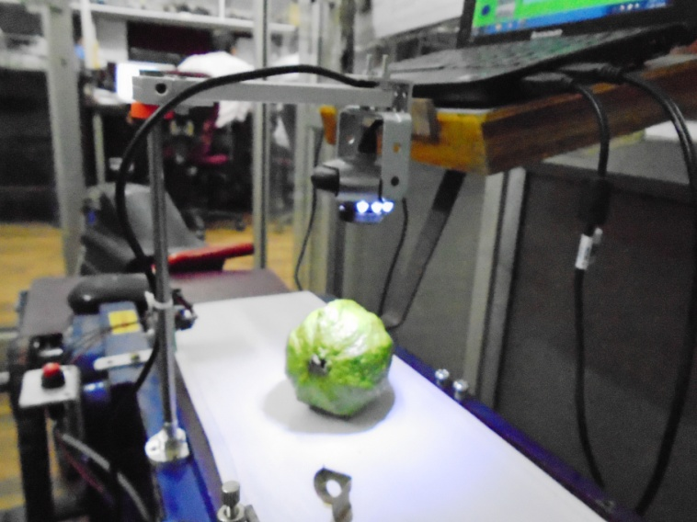
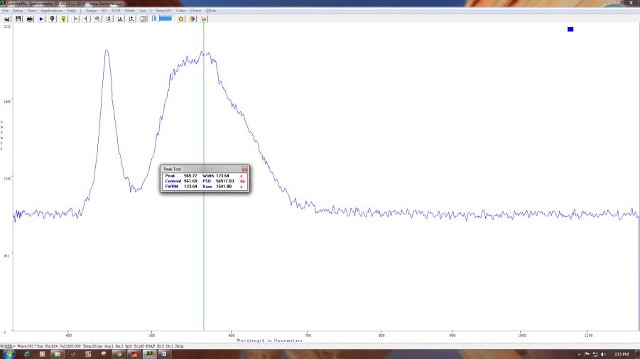
System Overview
• Image acquisition using 12 MP webcam
  • Controlled LED illumination system
  • HSI color space feature extraction
  • K-Nearest Neighbor (KNN) classifier
This plot indicates two peaks: the lower peak has a peak wavelength of 445.88 nm, and the upper peak has a peak wavelength of 565.77 nm. The CCT in the range of 5000 ºK to 8000ºK. This illumination system provides uniform light intensity across the fruit sample plane

Slide 5
Image Acquisition Setup
• iBall i12 webcam positioned 10 cm from fruit
  • Six white LEDs with adjustable brightness
  • Closed dark room environment
  • Controlled illumination using LUX meter

Slide 6
K-Nearest Neighbor (KNN)
• Non-parametric classification method
  • Uses training dataset for classification
  • Distance metric: Manhattan (Sum) distance
  • Evaluated 1-NN, 2-NN, and 3-NN

Slide 7
Training Process
• NI Color Classification Training Interface used
  • 100 samples per class (50 training, 50 testing)
  • HSI color space features extracted
  • Classifier integrated into LabVIEW GUI

Slide 8
Experimental Design
• Total samples: 400 guava fruits
  • 4 ripeness categories
  • Conveyor belt-based sorting
  • Testing under different lighting and angles

Slide 9
Results
• Average classification accuracy: 90%
  • Human grading reference: 100%
  • Repeatability: 100%
  • Processing time: < 40 ms per fruit

Slide 10
Performance Summary
Green: 100%
  Ripe: 80%
  Overripe: 88%
  Spoiled: 92%

Slide 11
Advantages
• Fast and objective grading
  • Low computational time
  • Cost-effective solution
  • Adaptable to other fruits

Slide 12
Limitations & Future Scope
• Sensitive to lighting conditions
  • Camera resolution affects accuracy
  • Need larger training datasets
  • Integration of multiple features can improve performance

Slide 13
Conclusion
• Machine vision system successfully classifies guava fruits
  • KNN with Manhattan metric effective
  • Comparable performance to human experts
  • Suitable for pre-packaging fruit grading

