Slide 1

AI-ASSISTED NETWORK INTRUSION DETECTION SYSTEMS FOR REAL-TIME THREAT IDENTIFICATION
Ashok Poudel¹, Prof. Anilkumar Ravjibhai Patel², Dr. Umesh Kumar³
¹Department of CSE, Faculty of Engineering & Technology Technology, Vadodara, Gujarat
²Department of CSE (AI & ML), Faculty of Engineering & Technology Technology, Vadodara, Gujarat
³ Department of CSE, Faculty of Engineering & Technology Technology, Vadodara, Gujarat

Slide 2
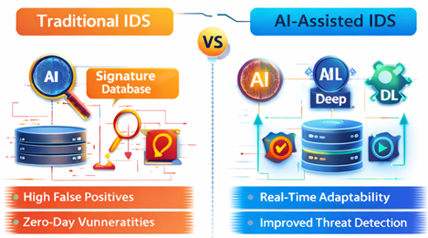
INTRODUCTION
Problem Statement & Motivation
The rapid expansion of cloud computing, IoT, and high-speed networks has increased the complexity and frequency of cyber threats.
Traditional signature-based intrusion detection systems are limited to known attack patterns and perform poorly against zero-day and evolving attacks.
Manual rule updates and high false-positive rates reduce the effectiveness and scalability of conventional IDS.
Real-time network environments require intelligent systems capable of adaptive learning and fast threat detection.
AI-assisted intrusion detection systems provide improved accuracy, adaptability, and real-time response to modern cyber threats

Slide 3
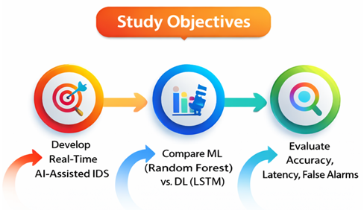
OBJECTIVES OF THE STUDY
To design and implement a real-time AI-assisted network intrusion detection system for effective threat identification.
To compare the performance of a machine learning model (Random Forest) and a deep learning model (LSTM) for intrusion detection.
To evaluate the models using standard metrics such as accuracy, precision, recall, and F1-score.
To analyze real-time performance in terms of detection latency and false alarm rate.

Slide 4

OVERALL METHODOLOGY
Network traffic is continuously captured from the operational network environment.
Raw traffic data undergoes preprocessing and feature extraction to generate structured inputs.
Machine learning and deep learning models are trained using labeled network traffic data.
Trained models perform real-time inference to classify traffic as normal or malicious, followed by alert generation.

Slide 5
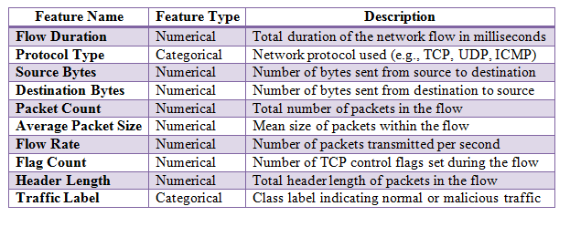
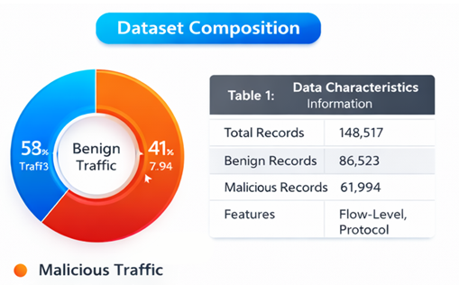
DATASET & FEATURE CHARACTERISTICS
The dataset consists of 148,517 network traffic records containing both benign and malicious instances.
Traffic data includes flow-level statistics and protocol-specific attributes relevant to intrusion detection.
Feature selection is applied to retain discriminative features while reducing computational overhead.
The labeled dataset supports supervised training and reliable evaluation of the proposed IDS.

Slide 6
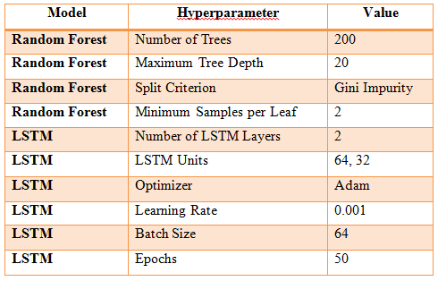
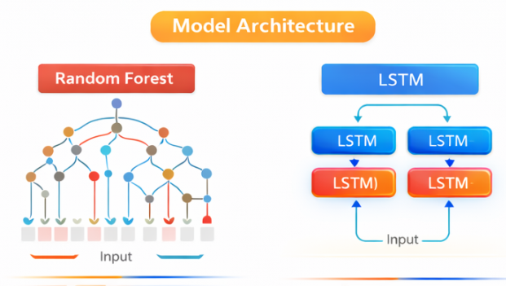
IMPLEMENTED MODELS & HYPERPARAMETERS
A Random Forest classifier is implemented to provide robust and fast intrusion detection using ensemble learning.
The Random Forest model is configured with 200 decision trees and a maximum tree depth of 20.
A Long Short-Term Memory (LSTM) neural network is used to capture temporal and sequential patterns in network traffic.
The LSTM model consists of two stacked LSTM layers with optimized learning parameters for real-time detection.

Slide 7
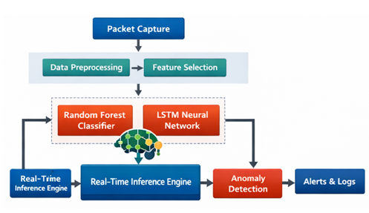
IMPLEMENTED AI-ASSISTED IDS ARCHITECTURE
Network traffic is monitored continuously in a real-time streaming environment.
Preprocessed traffic data is simultaneously passed to Random Forest and LSTM models for inference.
The parallel inference design balances detection accuracy and computational efficiency.
Alerts are generated immediately when malicious activity is detected.

Slide 8
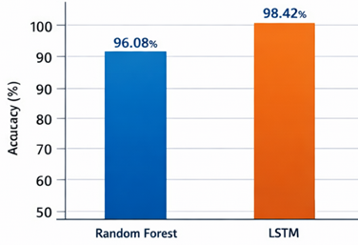
RESULTS – DETECTION ACCURACY
The Random Forest model achieved an accuracy of 96.08% in detecting malicious network traffic.
The LSTM model achieved a higher accuracy of 98.42%, outperforming Random Forest.
Improved accuracy of LSTM is attributed to its ability to learn temporal and sequential traffic patterns.
Results indicate the effectiveness of deep learning for complex intrusion detection tasks

Slide 9
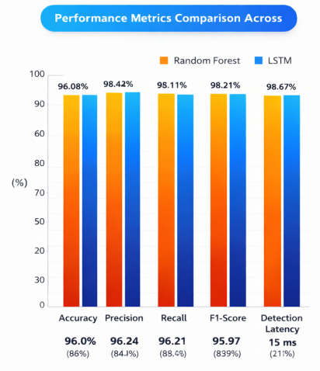
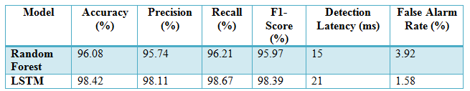
RESULTS – PERFORMANCE METRICS COMPARISON
Both models are evaluated using accuracy, precision, recall, and F1-score.
The LSTM model shows superior performance across all classification metrics.
Random Forest demonstrates lower detection latency, making it faster in inference.
The LSTM model significantly reduces the false alarm rate compared to Random Forest.

Slide 10
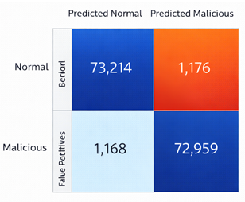

RESULTS INTERPRETATION
A clear trade-off is observed between detection accuracy and inference latency.
The LSTM model provides the best overall detection performance with minimal false alarms.
The Random Forest model offers faster inference, suitable for latency-sensitive environments.
Confusion matrix results confirm the reliability and robustness of the LSTM model for real-time IDS.

Slide 11
CONCLUSION
AI-assisted intrusion detection systems provide significantly higher accuracy than traditional signature-based IDS.
The proposed system successfully detects malicious network traffic in real time using machine learning and deep learning models.
The LSTM model outperforms the Random Forest model in accuracy, precision, recall, and F1-score.
Superior performance of LSTM is due to its ability to capture temporal and sequential network traffic patterns.
The Random Forest model offers lower detection latency, making it suitable for time-critical scenarios.
Both models demonstrate acceptable real-time performance with low inference delay.
The implemented AI-assisted IDS is practical, scalable, and effective for modern network security environments.

Slide 12
REFERENCES
Milyakina, A. (2018). Rethinking literary education in the digital age. Σημειωτκή-Sign Systems Studies, 46(4), 569-589.
Nwankwegu, J. A. (2021). DIGITAL TRANSFORMATION AND DIGITAL HUMANITIES: FOCUS ON LANGUAGE AND LITERARY STUDIES. Nigerian Journal of Arts and Humanities (NJAH), 1(1).
Agrawal, S. (2024). Teaching Literature in the Age of Digital Humanities. EMERGING PARADIGM: INNOVATIONS AND INSIGHT IN ENGLISH LITERATURE AND LANGUAGE RESEARCH IN THE DIGITAL AGE, 39.
London, J. A. (2016). Re-imagining the Cambridge School in the Age of Digital Humanities. Annual Review of Political Science, 19(1), 351-373.
Wang, N. (2022). The rise of a new paradigm of literary studies: The challenge of digital humanities. New Techno Humanities, 2(1), 28-33.
Chow, R. (2000). Modern Chinese literary and cultural studies in the age of theory: Reimagining a field. Duke University Press.
Cuff, D., Loukaitou-Sideris, A., Presner, T., Zubiaurre, M., & Crisman, J. J. A. (2020). Urban humanities: New practices for reimagining the city. MIT Press.
Mentz, S. (2009). Toward a blue cultural studies: The sea, maritime culture, and early modern English literature. Literature Compass, 6(5), 997-1013.

Slide 13
REFERENCES
Papa, E. (2025). (Re) Thinking Literary Interpretation in the Digital Age: AI, Virtual Reality, and Immersive Reading. Open Journal of Social Sciences, 13(4), 46-67.
Kumari, B. (2025). REIMAGINING CREATIVITY: LITERATURE IN THE DIGITAL AGE. Siddhanta's International Journal of Advanced Research in Arts & Humanities, 25-32.
Berry, D. M., & Fagerjord, A. (2017). Digital humanities: Knowledge and critique in a digital age. John Wiley & Sons.
Kwong, S. Y. (2025). Reimagining Modernity: Transcultural Narratives and the Reconstruction of Identity in Contemporary Global Literature. Literary Horizons Review, 1(2), 1-8.
Melnyk, O., Kyselova, I., & Tereshchuk, M. (2025). The Transformation of Literary Genres in the Digital Age. Studia Philologica, (2 (25)), 220-233.
Alhinai, M., & Al-Belushi, M. A. K. (2026). Reimagining the Knowledge Economy: A Critical Call to Re-Center the Humanities in Omani Higher Education. Journal of Arabian Studies, 1-18.
Zafar, Q., Gohar, S. G. A., Jawad, M., & Soomro, M. (2024). The Implications of Digital Culture for Contemporary Literature: Navigating new Narratives, Forms, and Reader Engagement in the Digital Age. Review of Education, Administration & Law, 7(4), 267-286.

Slide 14
REFERENCES
Hammond, A. (2016). Literature in the digital age: An introduction. Cambridge University Press.
Risam, R. (2018). New digital worlds: Postcolonial digital humanities in theory, praxis, and pedagogy. Northwestern University Press.
Batista, E. R. (2026). Reimagining alternative socioecological futures: Transformative narratives for a Second Scientific Revolution. Environmental Science & Policy, 176, 104319.
Raab, N. A. (2020). The humanities in transition from postmodernism into the digital age. Routledge.
Loizeaux, E. B., & Fraistat, N. (Eds.). (2002). Reimagining textuality: Textual studies in the late age of print. Univ of Wisconsin Press.
Cannon, M., & Potter, J. (2019). Pedagogies of production: Reimagining literacies for the digital age. In The Palgrave handbook of children's film and television (pp. 435-450). Cham: Springer International Publishing.
Atikurrahman, M. (2025). Reimagining textuality: Digital convergence and literary adaptation in Indonesia. Lingua Technica: Journal of Digital Literary Studies, 1(1), 63-71.

