Slide 1
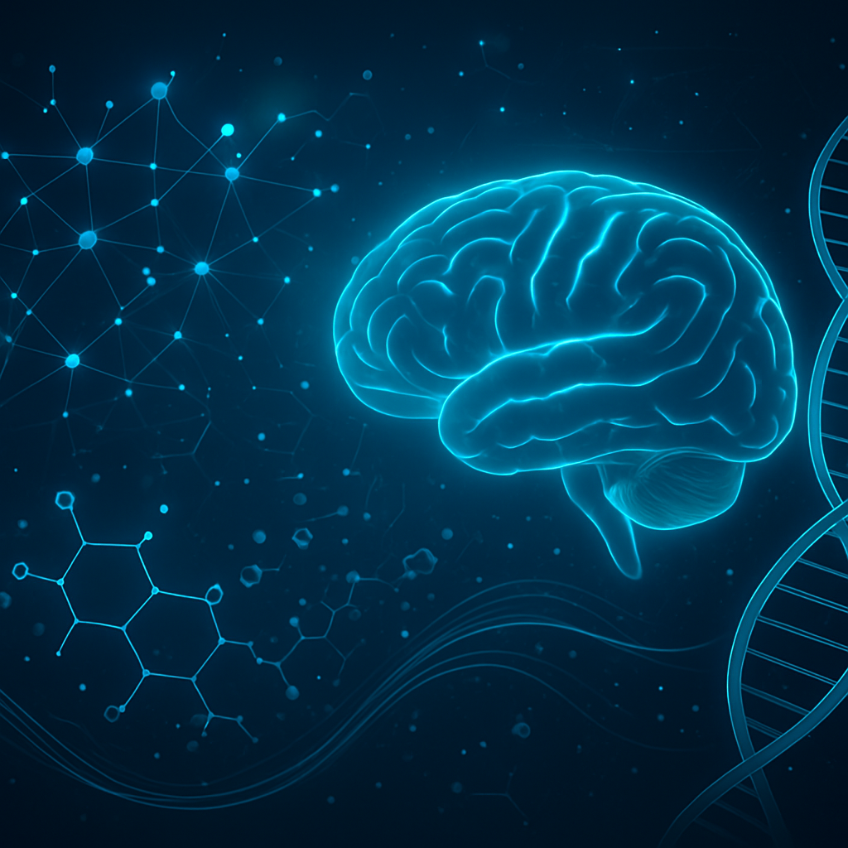
International Conference- AIRTTKC 2026
Computational Intelligence–Driven In Silico Drug Discovery for Targeting Human Tau Protein in Alzheimer’s Disease
Presenter
Vineeta Johri
Research Scholar, Department of Biotechnology, NIMS University, Jaipur

Slide 2
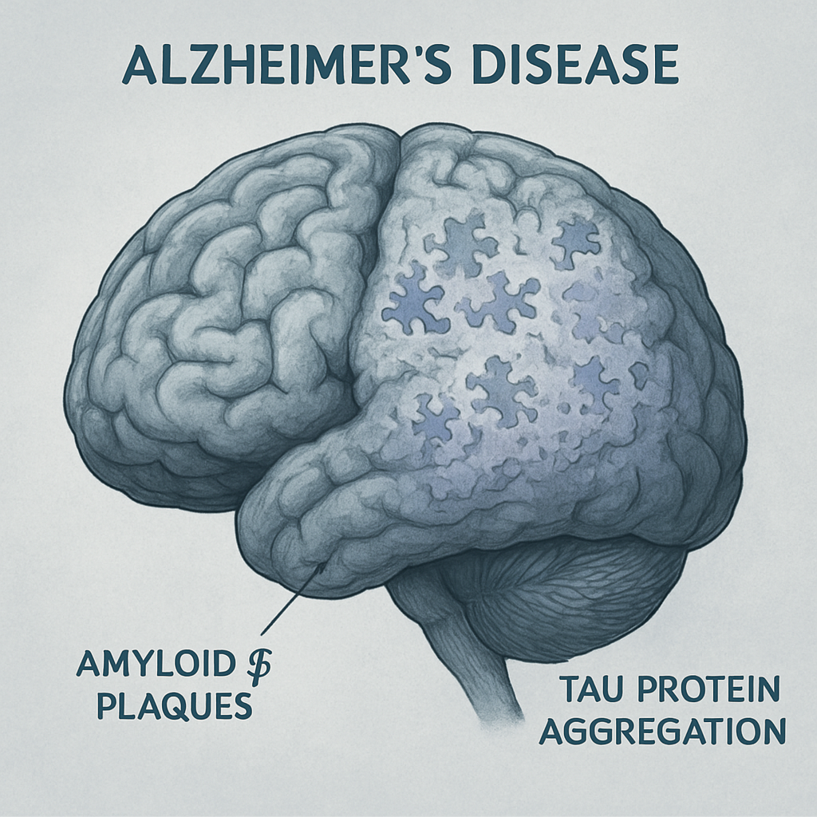

Alzheimer’s Disease
Progressive neurodegenerative disorder
Leading cause of dementia
Pathological hallmarks:
Amyloid-β plaques
Tau protein aggregation
Common signs include memory decline
Early diagnosis supports better care

Slide 3
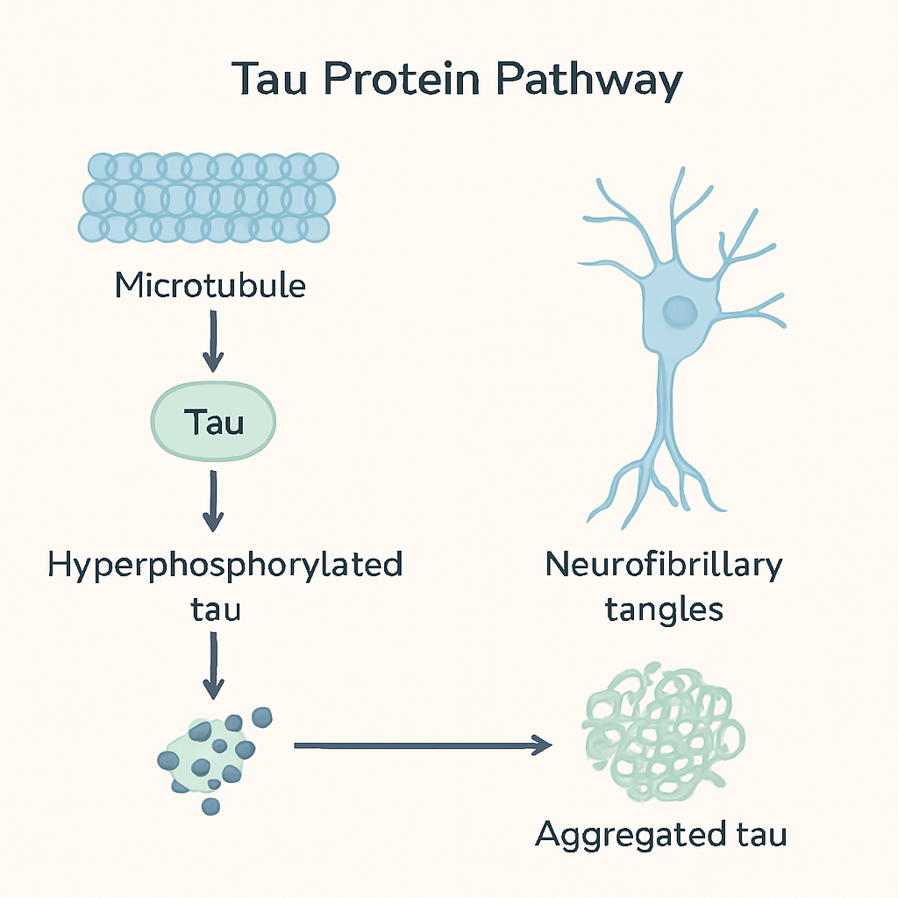
Why Target Tau Protein?
Microtubule-associated protein
Hyperphosphorylation → aggregation
Neurofibrillary tangles
Strong correlation with cognitive decline

Slide 4
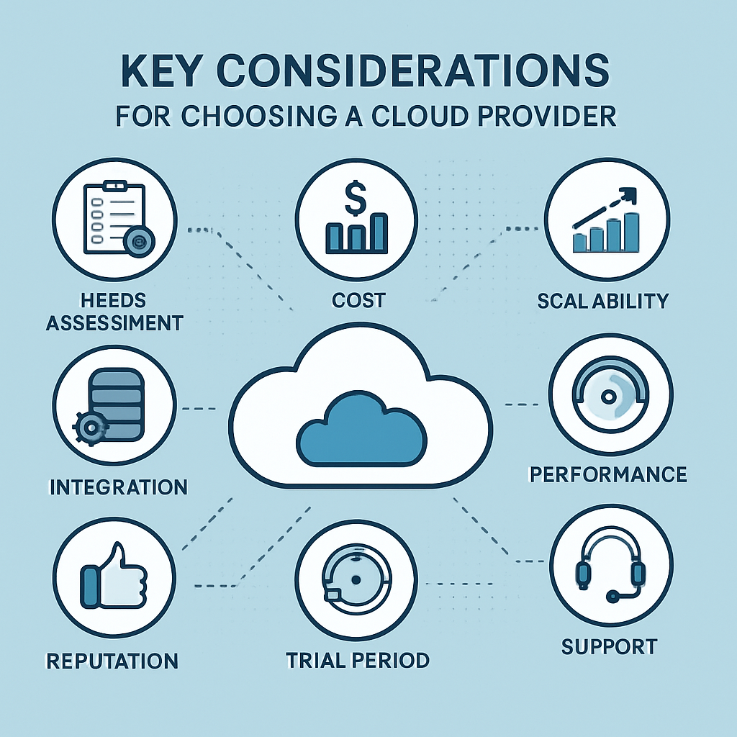
Why We Need AI
Traditional drug discovery is slow
High experimental cost
Low success rate
Need:
AI-driven computational screening
Automated compound prioritization

Slide 5
Aim & Objectives
Aim:
To develop a computational intelligence–driven framework to identify potential tau protein inhibitors.
Objectives:
Retrieve tau structure (PDB ID: 8Y76)
Prepare a natural compound dataset
Perform molecular docking
Analyze protein–ligand interactions
Identify lead candidates

Slide 6
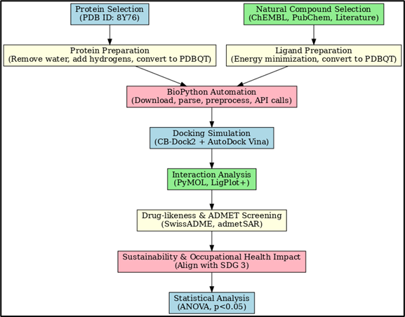
Computational Framework
Working Pipeline
Protein Retrieval (8Y76)
Structure Preparation (PyMOL)
Ligand Preparation (Python Colab + Py3Dmol)
Docking (AutoDock)
Interaction Analysis
Lead Ranking

Slide 7
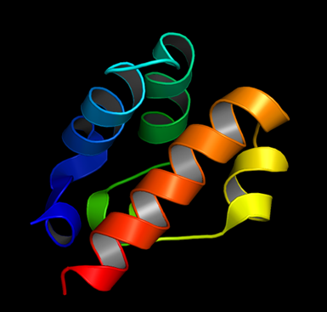
Protein Structure (8Y76)
High-quality structure
Disease-relevant conformation
Suitable for docking

Slide 8
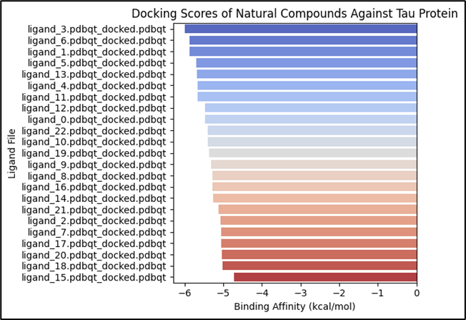
Docking Results Interpretation:
More negative binding energy shows
stronger affinity
Clear ranking of compounds
Top candidates shortlisted

Slide 9
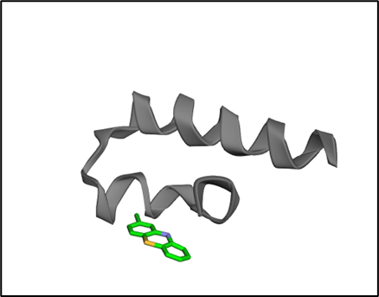
Interaction Analysis
Hydrogen bonding
Hydrophobic interactions
Stable binding within tau functional region
Lead compounds identified

Slide 10
Conclusion & Future Scope
Conclusion:
Computational intelligence accelerates drug discovery
Identified promising tau-targeting compounds
Framework supports data-driven decision making
Future Scope:
Machine learning-based affinity prediction
ADMET analysis
Experimental validation

Slide 11
Thank you everyone for listening to my work

