Slide 1

Hybrid Quantum–Classical Randomness-as-a-Service (HyQRaaS)
Real-time validation and service delivery via API
Team Members:
Udvik Konduru
Jitesh Kumar
Pravardhan
Gangadhara Rao Kommu

Slide 2
Motivation: Why High-Quality Randomness Matters
Cryptographic key generation depends on unpredictable bits
Authentication tokens and secure sessions require strong entropy
Weak randomness has caused real-world cryptographic failures
Reliable entropy is foundational to digital security

Slide 3
Observations from Recent Research
Quantum systems are theoretically non-deterministic
Practical hardware introduces noise and bias
Studies show measurable bias in quantum-generated sequences
Pure PRNG depends heavily on seed entropy quality
Conclusion line:
Neither pure PRNG nor pure QRNG alone guarantees reliability.

Slide 4
Objective of This Work
Improve entropy reliability and robustness
Reduce dependence on a single entropy source
Introduce runtime validation before output
Provide randomness as a secure service

Slide 5
Hybrid QRaaS Framework
Dual entropy integration (Quantum + Classical)
XOR-based entropy mixing
Runtime statistical validation
Health score generation
Service-oriented delivery (RaaS)

Slide 6
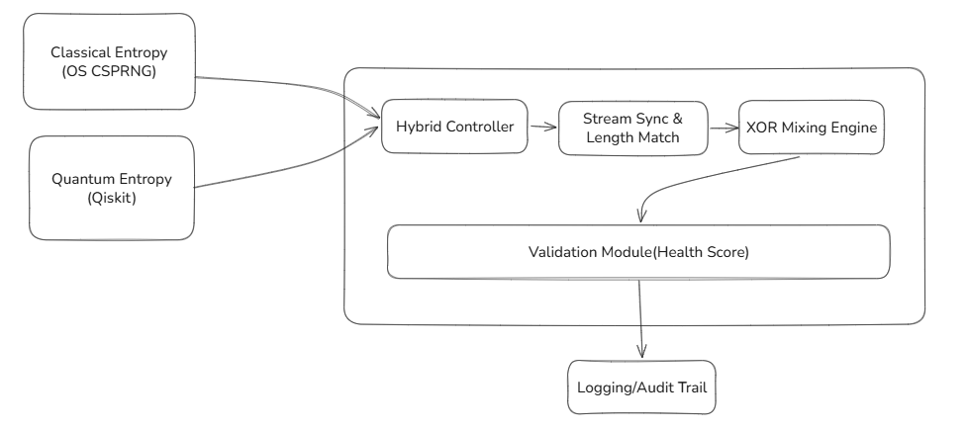
System Overview (Architecture)

Slide 7
System Overview (Architecture)
Pipeline:
User Request → API → Hybrid Controller → (Quantum Source + Classical Source) →
XOR Mixer → Validator → Response
Dual entropy integration
Runtime statistical validation
Observable and auditable randomness

Slide 8
Entropy Sources
Classical Source
  OS CSPRNG (aligned with NIST SP 800-90A concepts)
  Seeded from system entropy pool
Quantum Source
  Hadamard-based quantum circuit
  Qiskit simulation (development phase)
  Hardware QRNG integration planned

Slide 9
Hybrid Controller Mechanism
Collects entropy from both sources
Synchronizes bit streams
Performs byte-wise XOR mixing
Applies lightweight validation
Assigns runtime health score
Logs metadata for audit
Key Line:
  Ensures continuous, validated entropy delivery.

Slide 10
Comparative Positioning
Approach | Strength | Limitation
PRNG | Efficient | Deterministic
QRNG | Theoretically unpredictable | Hardware complexity & noise
Hybrid (HyQRaaS) | Improved reliability & fault tolerance | Integration overhead

Slide 11
Challenges
Simulator-based quantum entropy (current phase)
Lightweight statistical validation
Integration complexity
Performance overhead considerations

Slide 12
Future Work
Hardware-based QRNG integration
Full NIST SP 800-22 automation
Adaptive entropy mixing strategies
Distributed entropy nodes
Advanced anomaly detection

Slide 13
Conclusion
Hybrid entropy improves robustness over single-source models
Governance layer ensures runtime validation
Service-oriented design enhances scalability and auditability
HyQRaaS provides a practical entropy reliability framework

