Slide 1
AI as a Knowledge-Creation Tool: Industry 4.0, Infrastructure, and Sustainability in Emerging Markets
Mr. Piyush Kumar — Assistant Professor, Department of Management, Vishveshwarya Group of Institutions (piyushkumar5698@gmail.com)
Ms. Teena Singh — Assistant Professor, Department of Management, Vishveshwarya Group of Institutions (ts.singh670@gmail.com)
Abstract: In the Fourth Industrial Revolution, artificial intelligence (AI) leverages large-scale data, computational power, and advanced algorithms to transform knowledge creation and support Sustainable Development Goals (SDGs). This study frames AI as a research tool and examines its role in poverty reduction (SDG 1) and industry, innovation, and infrastructure (SDG 9) in emerging economies. Using content analysis of government reports, peer-reviewed literature, and international data, the findings show AI enhances data-driven insights, improves infrastructure reliability and efficiency (transportation, logistics), enables informed policy and economic decision-making, and supports financial inclusion, agriculture, and education—thereby advancing sustainable development. The study recommends increased government investment in AI and AI-based research in emerging economies to accelerate innovation and achievement of key SDGs.
KEYWORDS: AI · INDUSTRY 4.0 · INNOVATION · INFRASTRUCTURE · SUSTAINABILITY

Slide 2
Introduction — Context, Scope, and Purpose
Industry 4.0 (the Fourth Industrial Revolution) is reshaping how people live, work, govern, and produce. Building on previous revolutions—from mechanization and steam power, to electricity and mass production, to digital computing and automation—Industry 4.0 is distinguished by scale, scope, complexity, and the pervasive generation of information through interconnected devices and services. Schwab and other scholars argue this era is unprecedented because individuals can now create knowledge via data mining, pervasive mobile connectivity, and powerful computational resources. This card summarizes the historical arc, establishes the study's scope, and frames the research question: how does AI, as a knowledge-creation tool, influence poverty reduction (SDG 1) and industry, innovation, and infrastructure (SDG 9) in emerging economies?
Historical Foundations
Distinctive Features of 4IR
Research Gap
From 18th-century steam engines to 20th-century computing: each revolution transformed livelihoods and production relationships.
Ubiquitous connectivity, data-driven knowledge creation, and new economic models (sharing economy, platformization).
Limited empirical research on AI's direct role in poverty reduction, infrastructure development, and SDG attainment in emerging markets.
Purpose: To examine AI's transformative potential via content analysis, synthesizing literature on agriculture, finance, education, transport, and data infrastructure to derive practical implications for policy and investment in emerging economies.

Slide 3
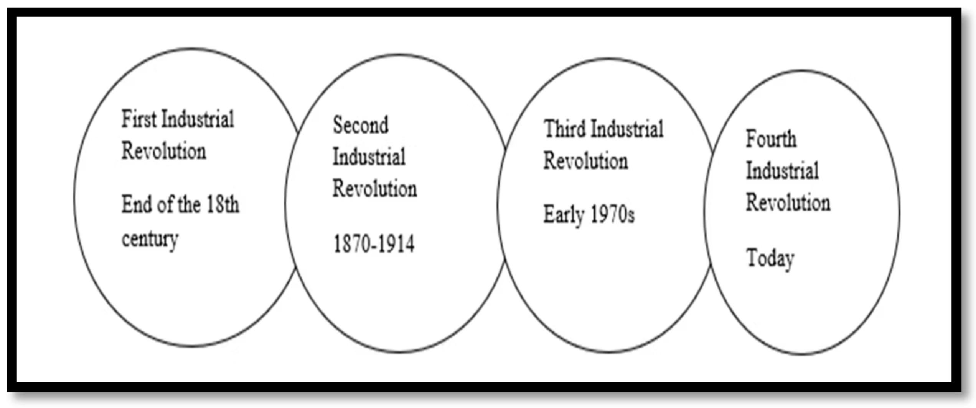

The Industry 4.0 Revolution — Characteristics & Risks
Industry 4.0 differs from prior revolutions in how it generates and leverages information: data accumulation, analytics, and machine intelligence enable new production relationships and services. Pervasive mobile processing, cloud storage, AI/ML algorithms, IoT, robotics, and distributed ledgers accelerate innovation while reshaping labor markets. Key advantages include improved productivity, faster decision-making, and new economic models; primary concerns include automation-driven displacement of low-skill jobs and the potential to exacerbate inequality unless managed through policy and institutional change.
Data & Knowledge Generation
Automation & Labor Disruption
New Economic Models
Individuals and organizations produce massive datasets that fuel machine learning and novel insights across sectors.
Robots, AI, and automation may replace routine work—policy responses are required to mitigate inequality and social tension.
Platform- and sharing-based services transform ownership, access, and service delivery (transportation, equipment sharing).
Figure note: The included diagram illustrates an evolutionary arc from the first to the fourth industrial revolution, highlighting technological enablers (steam, electricity, electronics, AI) and social-economic consequences.

Slide 4
Literature Review — AI: Origins, Definitions, and Scope
AI's conceptual roots trace to mid-20th-century pioneers: McCarthy (1955) proposed machine replication of learning; Minsky and McCarthy coined "Artificial Intelligence" (1956). Definitions emphasize intelligent problem-solving processes in machines—ranging from weak AI (tools simulating cognition) to strong AI (self-learning systems that adapt and network at scale). AI's economic applications span deep learning, robotization, dematerialization, gig economy platforms, and autonomous systems. Despite decades of research, AI remains a broad, evolving field that touches nearly every sector where computation assists human decision-making.
Weak AI
Strong AI
Economic Domains
Tools that simulate cognitive tasks—assistive models for human decision-making and pattern recognition.
Self-improving, networked systems capable of autonomous learning, scaling effects, and complex decision-making.
Finance, agriculture, transport, healthcare, and manufacturing — AI contributes predictive power and automation across these sectors.
Implication: Understanding AI's typology clarifies how targeted investments (e.g., weak-AI services vs. large-scale strong-AI infrastructure) can deliver measurable SDG outcomes in emerging economies.

Slide 5
Literature Review — Poverty: Definitions, Trends, and Regional Burden
Poverty is multidimensional: beyond income it includes deprivation of education, health, housing, sanitation, participation, and access to information. The UN differentiates absolute poverty (basic human needs) from overall poverty (broader deprivation and exclusion). Multidimensional indices incorporate education, health, and living standards. Although extreme poverty declined from 36% (1990) to 10% (2015), projections indicate the 2030 eradication target will be missed; ~6% may remain in extreme poverty by 2030. Sub-Saharan Africa remains the epicenter—housing over half of the extremely poor with an estimated 413 million people below $1.90/day and a high concentration of young, rural, agriculture-dependent populations.
Global Trends
Regional Concentration
Multidimensionality
Extreme poverty declined but progress is uneven; violent conflict and disasters exacerbate persistent deprivation.
Sub-Saharan Africa: fastest-growing share of global extreme poor; rural, young, agricultural workers are most affected.
Education, health, sanitation, and social inclusion are essential lenses for measuring and addressing poverty.
Takeaway: AI interventions must match the multidimensional reality of poverty—targeting health, education, finance, and infrastructure simultaneously to achieve meaningful impact.

Slide 6


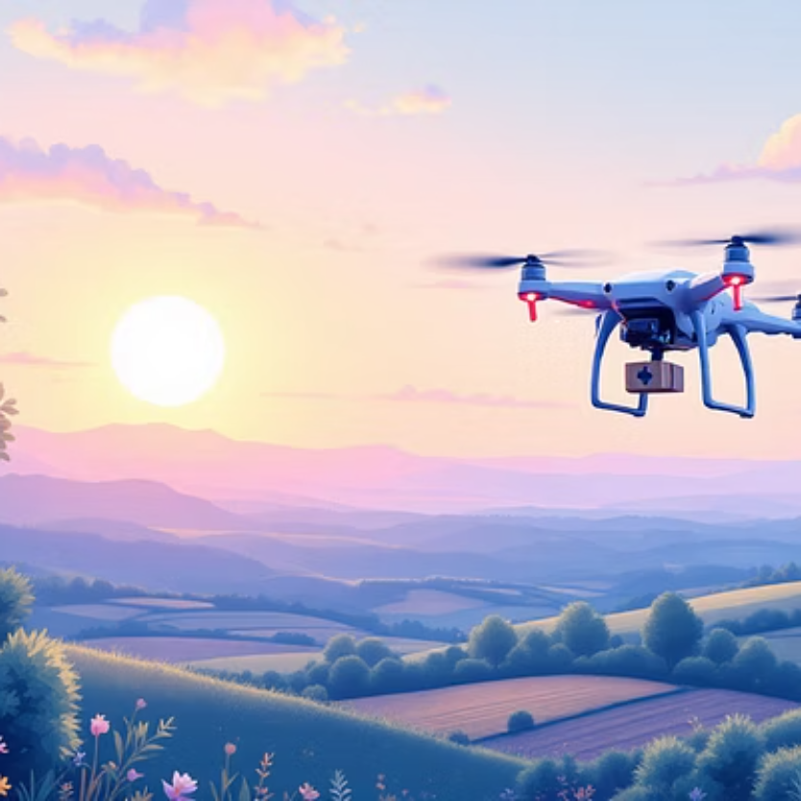



Empirical Review — AI Applications: Agriculture, Finance, and Healthcare
Empirical studies show AI's practical benefits across sectors crucial to poverty reduction:
Agriculture
Finance & Inclusion
Health & Logistics
AI improves disease detection, yield prediction, and land suitability analysis. Studies (Smith; Vincent et al.; Eli‑Chukwu) highlight machine learning + sensor networks and IoT for precision farming, enabling higher yields with fewer inputs and supporting drought- and disease‑resistant crop development.
AI-driven credit scoring and non-traditional data (mobile usage, transactions) expand micro‑credit access (e.g., M‑Shwari, Branch), reduce information asymmetry, and automate lending—fostering digital financial inclusion at scale.
Drones and AI analytics enable rapid medical deliveries and disaster response (Zipline, QCRI’s AIDR). AI integrates unstructured data to identify high-risk zones and allocate scarce resources efficiently.
Summary: Combined evidence indicates AI can boost productivity, improve targeting of interventions, reduce operational costs, and generate timely insights—though adoption barriers remain in low-income contexts.

Slide 7
Research Methodology — Content Analysis & Data Sources
Method: The study employs unobtrusive, secondary research using summative content analysis to quantify and interpret themes across textual sources. Content analysis enabled counting and contextual interpretation of keywords and concepts to reveal relationships between AI and SDG-relevant outcomes.
Data Collection
Analytic Approach
Limitations
Sources: government reports, World Bank/UN statistics, peer-reviewed journals, media articles, and institutional white papers.
Summative content analysis: keyword counts, contextual interpretation, thematic coding within a naturalistic paradigm.
Emerging nature of AI literature, inconsistent data availability in low-income settings, and reliance on secondary sources constrain causal inference.
Rationale: Summative analysis offers a scalable, non-invasive method to synthesize diverse literature and derive actionable insights for policymakers and researchers in emerging markets.

Slide 8
AI & Infrastructure: Transport, Energy, and Urban Systems
Infrastructure Challenges
AI Interventions & Case Studies
Over 4 billion people lack internet access (90% in developing countries). Approximately 2.6 billion lack reliable electricity; 2.3 billion lack basic sanitation. Limited industrial processing (≈30% of agricultural products processed in developing countries) reduces productivity and value capture.
Transport: AI improves routing, forecasting, and safety—autonomous vehicles, truck platooning, and platforms (Uber, Lyft, Via) improve reliability and reduce emissions.
Urban Traffic: Bengaluru (Siemens) and Alibaba’s City Brain optimize signals and congestion using real-time video and sensors.
Drones: Zipline (Rwanda) demonstrates medical logistics in low-infrastructure settings; large cargo drones (Sichuan Tengden) exemplify scale potential.
Energy & Processing: Renewable energy employment growth and AI-driven efficiency can catalyze industrialization and reduce emissions.
Economic impact estimates suggest AI could raise global output by ~$13 trillion by 2030. AI-enabled transport and infrastructure improvements also lower accident rates and greenhouse gas emissions, boost trade efficiency, and support SDG 9 when paired with strategic investment.

Slide 9


Poverty Mapping, Data, and Targeting — How AI Locates and Serves the Poor
Precise targeting is essential for poverty alleviation. AI leverages alternative, low-cost data sources—satellite imagery, mobile metadata, social media, VAT records—to map poverty with unprecedented granularity. Stanford and other teams have trained models on high-resolution satellite images to predict economic indicators across African countries, validating outputs against household surveys. QCRI’s AIDR and machine‑learning poverty maps (anonymous Facebook ad data) exemplify how AI tools improve disaster response, identify food‑insecure regions, and allocate resources more effectively.
Poverty Mapping
Alternative Data
Combines imagery with ML to estimate income, access to water/markets, and infrastructure proximity—improves targeting for interventions.
Mobile and transaction data correlate strongly with education and income—used to extend microcredit, identify high-risk regions, and optimize aid delivery.
Result: AI-driven mapping reduces survey costs, accelerates insight generation, and enables policymakers to direct scarce resources where they matter most—if data privacy and representativeness challenges are addressed.

Slide 10

Conclusions, Policy Implications, and Recommendations
Conclusion: AI, framed as a knowledge-creation tool, demonstrates strong potential to accelerate SDG progress—particularly SDG 1 (poverty reduction) and SDG 9 (industry, innovation, infrastructure)—by improving data-driven decision-making, enhancing agricultural productivity, expanding digital financial inclusion, optimizing transport and logistics, and enabling precise poverty mapping. Evidence indicates tangible impacts in agriculture, finance, healthcare logistics, and urban planning. However, adoption in emerging economies is constrained by limited data, weak digital infrastructure, capacity gaps, and socio-political risks related to inequality and displacement.
Policy & Investment
Capacity & Inclusion
Prioritize public investment in digital infrastructure, data ecosystems, and AI R&D to unlock inclusive economic benefits.
Invest in digital literacy, vocational retraining, and education technologies to mitigate job displacement and broaden participation.
Ethics & Governance
Targeted Applications
Implement data governance, privacy safeguards, and equitable deployment frameworks to prevent bias and exclusion.
Scale proven interventions: AI-driven agriculture (disease detection, yield forecasting), fintech inclusion (non-traditional credit scoring), and logistics (drones, optimized transport).
Final recommendation: Emerging-economy governments should increase investment in AI research, public-private collaborations, and targeted pilots to translate AI’s promise into measurable SDG outcomes—especially for poverty eradication and resilient infrastructure development.
Note: This synthesis is derived from content analysis of contemporary literature, reports, and case studies; continued empirical research and careful implementation are necessary to realize AI’s equitable benefits.

