Slide 1
Trace Element Analysis using Particle Induced X-ray Emission (PIXE) Technique
Assessment of Soil Quality near Automobile Sector of Sambhajinagar District
Chandrashekhar Nivrutti Wani
Department of Applied Sciences, Nims University Rajasthan, Jaipur-303121, India
Sanjivani K. B. P. Polytechnic, Kopargaon (Maharashtra)-423603, India
Guide: Dr. Harish Kumar
Department of Applied Sciences, Nims University Rajasthan, Jaipur-303121, India

Slide 2
Abstract & Overview
Trace Element Analysis in Sambhajinagar Soil
This study investigates the environmental impact of the automobile industry on local soil quality, utilizing advanced nuclear analytical techniques to quantify heavy metal contamination.
* Research Objective
Quantify trace metal concentrations in surface soils (0–10 cm) surrounding the automobile industrial sector of Sambhajinagar.
* Data & Methodology
Analysis of secondary dataset from 2023–2025 surveys (15 composite samples) using PIXE (Particle Induced X-ray Emission) for high-sensitivity multi-element profiling.
* Key Findings (Mean Concentrations)
Pb ~78.6 mg/kg Zn ~243.5 mg/kg Cd ~1.6 mg/kg
Cu ~58.2 mg/kg Ni ~31.4 mg/kg
* Enrichment Status
High Enrichment: Lead, Zinc, and Cadmium markedly above natural background levels.
Moderate/Low: Copper showed moderate elevation; Nickel remained near crustal baseline.
* Primary Sources
Contamination attributed largely to anthropogenic sources: vehicular emissions, tire wear, and industrial material deposition.
Critical Implication
Findings indicate significant enrichment of Lead (Pb) and Zinc (Zn) beyond safe limits, primarily driven by vehicular emissions and industrial activities, posing potential ecological and health risks.

Slide 3
Introduction: The Heavy Metal Challenge
Urban & Industrial Soil Contamination
* Persistent Pollutants
Urban and industrial soils are accumulating non-biodegradable metals like Lead (Pb), Cadmium (Cd), Zinc (Zn), Copper (Cu), and Nickel (Ni), creating long-term environmental liabilities.
* Anthropogenic Sources
Primary contributors include vehicular emissions (exhaust, catalytic converters), component wear (tires, brakes, galvanized parts), and industrial waste dumping.
* Exposure Pathways
Contaminants enter the ecosystem through dust inhalation, direct ingestion, uptake by crops in peri-urban agriculture, and leaching into groundwater systems.

Slide 4
Study Aim and Study Location
Study Aim
To establish comprehensive multi-element profiles and determine contamination levels in the rapidly developing automobile sector of Sambhajinagar using PIXE analysis.
Study Location
*Geographic Context
The study focuses on the Sambhajinagar (Aurangabad) automobile industrial sector in Maharashtra, India. This rapidly developing zone hosts major car manufacturing plants, component suppliers, and service hubs.
*Environmental Setting
Characterized by a semi-arid climate with distinct seasonal patterns. The local topography is relatively flat, with soils derived from basaltic parent material and alluvium, typical of the Deccan Trap region.
* Pollution Pressures
The area experiences high traffic density, industrial emissions from assembly/paint shops, and significant dust resuspension, creating potential hotspots for heavy metal accumulation.

Slide 5
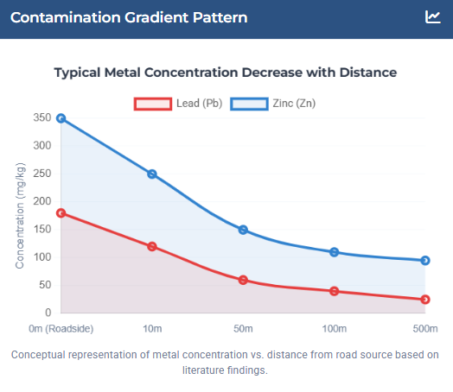
Literature Review: Global Context
Global Pollution Patterns
* Widespread Threat
Recent evaluations indicate 14–17% of global croplands exceed safe metal limits, posing risks to agriculture and health (Hou et al., 2025). Industrialized regions in Eurasia show high accumulation of toxic metals.
* Urban Enrichment
Urban soils consistently show enrichment of Pb, Zn, Cu, and Cd due to traffic and industry. Studies in China revealed nearly all urban samples exceeded natural background levels (Wei & Yang, 2010).
* Traffic & Industrial Sources
Roadside Gradients
Research confirms steep declines in metal concentrations (Pb, Zn, Cu) with distance from major roads, directly linking contamination to vehicular emissions (Christoforidis & Stamatis, 2009).
Indian Scenario
Cities like Delhi and Bengaluru report severe pollution. Road dust in Delhi is heavily polluted with Zn and Pb (Suryawanshi et al., 2016), while industrial areas in Bengaluru show contamination up to 1.5m depth (Dhakate et al., 2020).
"The contamination indices... showed moderate to high levels of pollution in fast industrializing cities, highlighting common anthropogenic sources."
— Wei & Yang (2010)

Slide 6
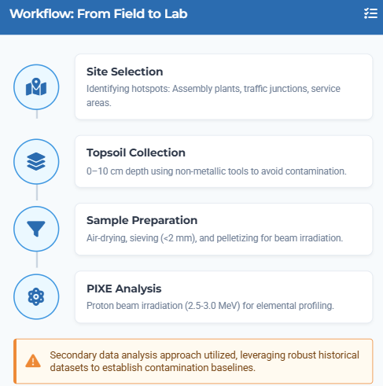
Methodology: Sampling & Data Collection
Survey Period: 2023–2025
* Sampling Sites
15 composite soil samples were collected from diverse locations including assembly factories, parking yards, service stations, and major arterial roads within the Sambhajinagar industrial estate.
* Surface Layer Focus
Topsoil samples (0–10 cm depth) were targeted to specifically assess recent anthropogenic contamination from atmospheric deposition and industrial activities.
* Composite Strategy
Each sample was a composite of multiple sub-samples to ensure representativeness. Debris and stones were removed, followed by air-drying and sieving (<2 mm) for homogeneity.
* Quality Assurance
Sampling covered pre- and post-monsoon seasons to smooth short-term variations. Analysis was performed in triplicate using PIXE with certified

Slide 7
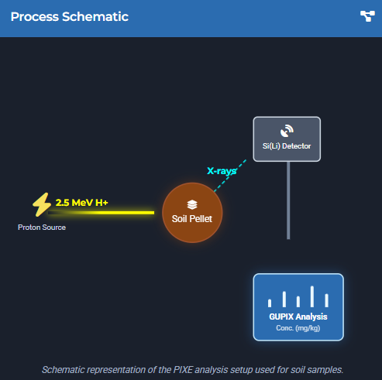
Methodology: PIXE Analysis
Particle Induced X-ray Emission
* Experimental Setup
Samples were irradiated using a 3 MV tandem accelerator. A proton beam of 2.5–3.0 MeV energy bombarded the pelletized soil samples in a vacuum chamber.
* Detection Mechanism
A Si(Li) energy-dispersive detector measured the characteristic X-rays emitted when protons ejected inner-shell electrons from target atoms.
* Quantification & Software
Spectra were analyzed using GUPIX software. Fundamental parameter methods corrected for matrix effects, ensuring high quantitative accuracy.
* Key Advantages
Non-destructive, multi-elemental capability, and high sensitivity (ppm level) make it ideal for detecting trace heavy metals like Pb, Cd, and Zn.
"PIXE offers a rapid, simultaneous profile of major and trace elements without complex chemical digestion, preserving sample integrity."

Slide 8
Results Overview: Key Findings
High Enrichment
* Pb, Zn, Cd
Significantly Elevated
Lead (Pb) levels > 4x natural background (EF > 4).
Zinc (Zn) consistently high (>200 mg/kg), indicating strong anthropogenic input.
Cadmium (Cd) shows highest enrichment factor (up to 10) due to low natural baseline.
* Spatial Hotspots
Assembly Zone
Critical Areas
Highest concentrations found at automobile assembly plant boundaries.
Central arterial roads show peak Pb and Zn levels.
Contamination gradient declines significantly 1-2 km from industrial core.
Overall Assessment
Clear evidence of industrial and vehicular footprint on soil quality, with specific metals posing potential long-term accumulation risks.
Moderate/Low Impact
* Cu, Ni
VARIABLE LEVEL
Copper (Cu) moderately elevated (~58 mg/kg), with localized peaks near workshops.
Nickel (Ni) remains near or below crustal background (~31 mg/kg).
Ni suggests primarily geogenic origin rather than industrial pollution.
* Pollution Indices
Enrichment Factor (EF) and Geo-accumulation Index (Igeo) confirm moderate to strong pollution status for Pb and Cd, validating anthropogenic sources.
* Other Elements
Arsenic (As) largely undetectable or low (<5 mg/kg). Iron (Fe) and Manganese (Mn) levels consistent with local basaltic soil matrix.

Slide 9
Heavy Metal Concentrations: Study vs. Baseline
Element | Study Mean | Baseline* | Enrichment
Lead (Pb) | 78.6 | 20.0 | ~3.9x
Zinc (Zn) | 243.5 | 95.0 | ~2.6x
Cadmium (Cd) | 1.6 | 0.3 | ~5.3x

Slide 10
Lead and Zinc Analysis: The Most Enriched Metals
Lead (Pb) Profile ~78.6 mg/kg Mean Conc. (Hotspots >100) Approx. 4x higher than natural crustal background (20 mg/kg). Sources: Legacy vehicle emissions, industrial paints, and batteries. Enrichment Factor (EF) > 4 indicates significant anthropogenic origin. | Zinc (Zn) Profile ~243.5 mg/kg Highest Absolute Levels Peaks exceed 300 mg/kg at assembly & service sites. Sources: Tire wear (ZnO), brake linings, and galvanized parts. Correlates strongly with traffic density and industrial activity. | Regional Comparison Igeo: Mod-Strong Pollution Classification Levels align with polluted roadside soils in Delhi and Ludhiana. Similar to industrial zones in Guangzhou, China. Consistent pattern of urban-industrial metal enrichment.
Health Implication (Pb) Lead is neurotoxic even at low levels. Persistent surface soil contamination poses risks to children via dust inhalation/ingestion. | Ecological Stress (Zn) While an essential nutrient, excess Zn can inhibit soil microbial activity and stress plant root systems, reducing soil quality. | Mitigation Priority Hotspots near assembly plants require dust control measures. Pb and Zn levels warrant regular monitoring and potential remediation.

Slide 11
Analysis: Copper, Nickel & Cadmium
Copper (Cu) 58.2 mg/kg Moderately Elevated * Average concentration slightly above crustal baseline (45 mg/kg). * Localized hotspots (>100 mg/kg) found near service workshops. * Sources: Brake pad wear dust and electrical component waste. | Nickel (Ni) 31.4 mg/kg Below Background * Concentration significantly lower than crustal average (~68 mg/kg). * Indicates predominantly geogenic (natural) origin. * Minimal anthropogenic input from auto sector emissions. | Cadmium (Cd) 1.6 mg/kg Highly Enriched ~5.3x higher than natural background (0.3 mg/kg). Highest Enrichment Factors (EF 5–10) of all trace metals. Sources: Tire rubber wear, lubricants, and battery waste.
Bioavailability Concern Even low absolute Cd levels pose significant risks due to high plant uptake potential, threatening local urban agriculture. | Source Attribution Contamination profiles clearly distinguish between industrial-sourced metals (Cd, Cu) and natural background elements (Ni). | Health Implications While Ni is safe, the persistence of Cd (a known carcinogen) requires strict monitoring despite lower absolute quantities.

Slide 12
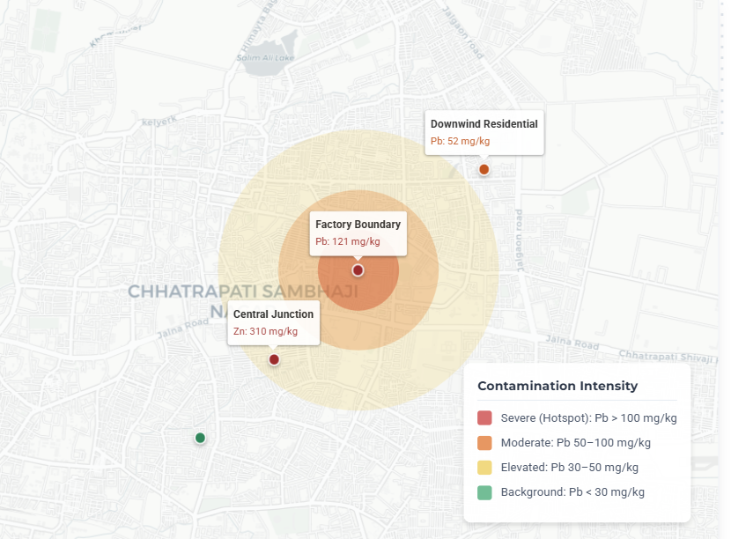
Spatial Distribution
* Contamination Gradient
A distinct radial dispersion pattern is observed. Metal concentrations (Pb, Zn) are highest at the industrial core and arterial roads, declining sharply over a 1–2 km distance toward the periphery.
* Hotspot Comparison
The contrast is significant:
• Boundary Zone: Pb ~120 mg/kg, Zn >300 mg/kg
• Residential (Downwind): Pb ~50 mg/kg, Zn ~150 mg/kg
* Source Attribution
The spatial layout confirms point-source emissions (factories) and localized deposition (vehicle idling areas) as the primary drivers, rather than diffuse regional background.

Slide 13
Discussion & Context
* Alignment with Regional & Global Studies
Pb (~80 mg/kg) and Zn (~243 mg/kg) levels mirror high-traffic zones in Ludhiana/Delhi (India) and industrial areas in Guangzhou (China). Nickel remains near geogenic background, consistent with other Indian soil studies.
* Legacy vs. Active Sources
High Pb persists despite unleaded fuel phase-outs, indicating legacy accumulation and ongoing industrial inputs (paints, batteries). Zn/Pb Ratio suggests vehicular wear (tires/brakes) is a dominant active contributor.
* Efficacy of PIXE Technique
Validated as a superior tool for environmental monitoring: offers multi-element detection, high sensitivity (ppm level), non-destructive analysis, and minimal sample preparation compared to traditional chemical digestion methods.
* Limitations & Future Scope
Study relied on secondary data (2020-2022) without a site-specific pristine baseline. Future research requires primary sampling, metal speciation analysis, and direct bioavailability assessments for crops.

Slide 14
Environmental & Health Implications
Risk Assessment & Ecological Impact
* Human Health Risks
Lead (Pb): Neurotoxic risks, particularly affecting cognitive development in children via dust inhalation.
Cadmium (Cd): A known carcinogen causing renal damage; accumulates in the body with a long biological half-life.
* Ecological Consequences
Elevated Zinc (Zn) and Copper (Cu) levels can inhibit soil microbial activity, disrupt nutrient cycling, and suppress plant root growth, affecting local biodiversity.
* Critical Thresholds Exceeded
Cd hotspots (3–5 mg/kg) exceed safe agricultural limits (~3 mg/kg), posing immediate risks for peri-urban farming. Pb levels >100 mg/kg in residential zones warrant intervention.
* Mitigation Priorities
Immediate restriction on food cropping in hotspots, implementation of dust

Slide 15
Conclusions & Recommendations
Summary of Findings
* Significant Enrichment
Lead (Pb), Zinc (Zn), and Cadmium (Cd) levels markedly exceed natural baselines, confirming anthropogenic pollution.
* Spatial Correlation
Hotspots are strictly co-located with industrial assembly lines and high-density traffic corridors, indicating point-source origins.
* Varied Impact
While heavy metals show high accumulation, Nickel (Ni) remains near geogenic levels, and Copper (Cu) shows moderate elevation.
* Technique Efficacy
PIXE demonstrated high effectiveness for rapid, multi-element soil profiling without extensive sample preparation.

Slide 16
Thanks . . . .

