Slide 1
An Empirical Study on the Impact of Fintech Innovation on Sustainable Economic Growth in India
Presented by: Ms. Divya Bhatia
International Conference
Focus: Impact of fintech in India’s growth

Slide 2
Abstract
FinTech is transforming the global and Indian financial system by improving speed, accessibility, and efficiency
This study examines the impact of fintech on sustainable economic growth in India
Focus on:
Digital financial services
Mobile payments
Digital lending
Financial inclusion
Key contributions:
Improved access to finance
Support to SMEs
Growth of digital entrepreneurship
Better financial efficiency
Major challenges:
Cybersecurity risks
Regulatory issues
Low digital literacy
Conclusion:
Need for balanced regulation, strong infrastructure & financial awareness

Slide 3
Introduction
FinTech Concept
FinTech refers to the use of innovative technologies to improve financial services
Transforms traditional systems into faster, efficient, and accessible services
Includes tools like mobile banking, digital wallets, AI, and blockchain
🇮🇳 India Growth
Rapid growth due to internet penetration & smartphone adoption
Strong support from government initiatives like Digital India & UPI
India emerging as a leading fintech market
Expected to reach $1 trillion market size by 2032
Role & Study Focus
Promotes financial inclusion for unbanked population
Enhances efficiency, transparency, and cost reduction
Supports digital economy and entrepreneurship
Study examines fintech’s role in sustainable economic growth in India

Slide 4
Literature Review
Existing studies identify fintech as a transformative force reshaping financial systems, improving service delivery, and enhancing user experience (Sharma & Gupta, 2021)
Fintech significantly improves financial accessibility through mobile payments, digital lending, and online platforms, reducing reliance on traditional banking systems (Brown & Singh, 2020)
Contributes to sustainable economic growth by increasing financial efficiency, optimizing resource allocation, and lowering transaction costs (Brown & Singh, 2020)
Enhances banking sector efficiency and productivity, while strengthening financial inclusion within formal financial institutions (Kumar & Rajan, 2023)
Promotes entrepreneurship and SME development by enabling faster and easier access to credit and financial tools (Brown & Singh, 2020)
Supports rural economic development by expanding financial access in underserved regions through digital ecosystems and innovative technologies (Patel & Verma, 2022)

Slide 5
Objectives
1. To critically examine the concept and evolution of fintech innovation in India.
2. To analyze the role of fintech in fostering sustainable economic growth in India..
3. To assess the contribution of fintech towards financial inclusion and overall economic development.
4. To identify and evaluate the key challenges and emerging opportunities associated with fintech growth in India.

Slide 6
Research Methodology
📑 Research Design
Descriptive & analytical approach
Focus on fintech & sustainable growth
🧾 Data Collection
Primary data via structured questionnaire
Captures user perception & usage
👥 Sample Design
Fintech users (students, professionals, general public)
Sampling: Convenience method
Sample size: 162 respondents
📈 Data Analysis
Percentage analysis
Bar graphs & pie charts
Correlation
📋 Questionnaire
👥 Respondents
📊 Data Collection
📈 Analysis

Slide 7
Table 1:To study the relationship between fintech awareness and its perceived impact on economic growth in India.
Awareness (Q1) | R1 | Influence (Q5) | R2 | d | d²
98 | 1 | 59 | 2 | -1 | 1
59 | 2 | 76 | 1 | 1 | 1
7 | 3 | 23 | 3 | 0 | 0
0 | 5 | 2 | 4.5 | 0.5 | 0.25
3 | 4 | 2 | 4.5 | -0.5 | 0.25
Sum of d² = 2.5
Step 2: Apply formula:
rₛ = 1 - (6Σd² / n(n²-1))
rₛ = 1 - (6×2.5 / 5(25-1))
rₛ = 1 - (15 / 120)
rₛ = 0.875
As per Table 1, the value of rₛ = 0.875 indicates a strong positive correlation between Q1 and Q5. This means that students who scored high in Q1 also tended to score high in Q5, and those with low scores in Q1 also had low scores in Q5. The correlation is very strong as the value is close to +1, though not perfect, indicating minor variations in ranking. Overall, the performance across both questions is consistent.

Slide 8
Table no. 2 Spearman Rank Correlation Analysis between Government Initiatives and Regulatory Challenges Affecting the Growth of Fintech in India
Spearman Rank Correlation Formula:
ρ = 1 - (6 Σd²) / [n(n² - 1)]
Σd² = 14, n = 5
ρ = 1 - (6 × 14) / [5(25 - 1)]
ρ = 1 - 84 / 120
ρ = 1 - 0.7
ρ = 0.3
Q3 | R1 | Q19 | R2 | d | d²
3 | 4 | 91 | 2 | 4 | 4
2 | 5 | 8 | 4 | 1 | 1
18 | 3 | 24 | 3 | 0 | 0
76 | 1 | 89 | 1 | 0 | 0
63 | 2 | 0 | 5 | -3 | 0
The Spearman Rank Correlation coefficient (ρ = 0.3) indicates a weak positive relationship between government initiatives and regulatory challenges in fintech growth. While both move in the same direction, the link is not strong, suggesting that regulatory issues persist despite policy support. Hence, better alignment between government policies and regulations is needed for sustainable growth.

Slide 9
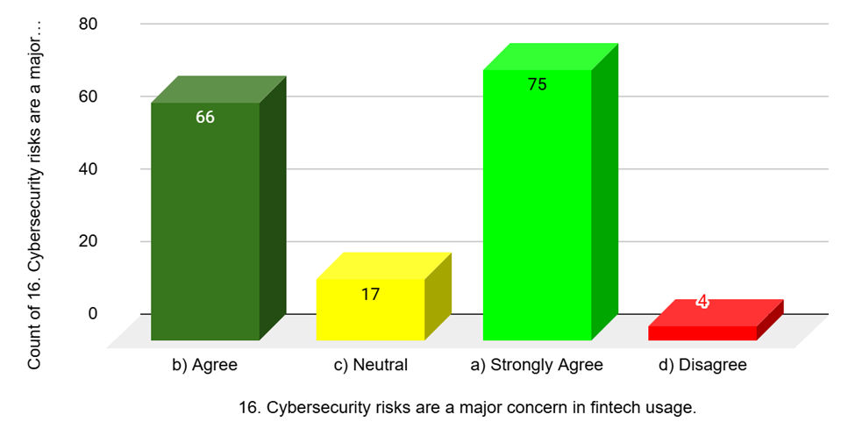
Results and Discussions
Figure 8: Cybersecurity risks are a major concern in fintech usage
As depicted in Figure 8, approximately 70–80% of respondents agree that cybersecurity risks are a major concern in fintech usage. This highlights a strong awareness of potential threats such as data breaches, fraud, and hacking. While fintech offers convenience and efficiency, users remain cautious about the safety of their financial information. The findings emphasize the need for stronger security measures, regulatory frameworks, and user awareness programs to build trust and ensure safe adoption of fintech services in the digital financial ecosystem.

Slide 10
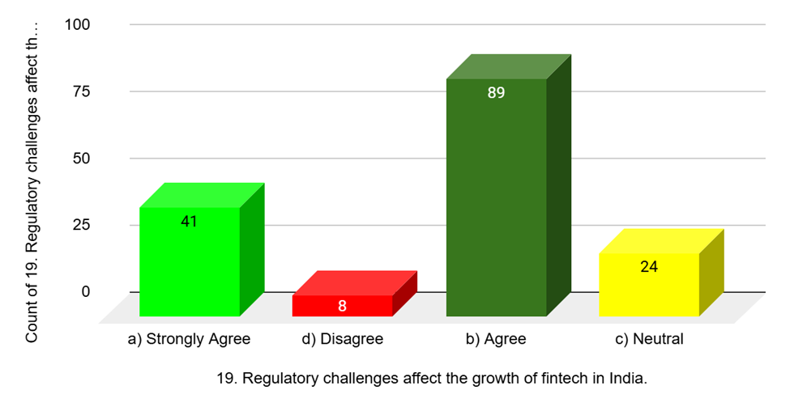
Figure 10: Regulatory challenges affect the growth of Fintech in India
Figure 10 depicts that Nearly 65–75% of respondents agree that regulatory challenges impact the growth of fintech in India. This suggests that while fintech is expanding rapidly, uncertainties in policies, compliance requirements, and legal frameworks create obstacles. Respondents perceive the need for balanced regulations that encourage innovation while ensuring consumer protection. The findings indicate that a clear, supportive, and adaptive regulatory environment is essential to sustain fintech growth and maximize its contribution to long-term economic development.

Slide 11
Findings
80–85% respondents indicate high awareness and adoption of fintech services in India
75–80% respondents acknowledge the strong role of government initiatives (Digital India, UPI, Aadhaar) in fintech growth
80–90% respondents perceive fintech as a key driver of economic growth through efficiency and cost reduction
80–85% respondents confirm fintech’s significant contribution to financial inclusion, especially in underserved areas
75–80% respondents agree that fintech facilitates SME growth by improving access to finance
75–80% respondents recognize fintech’s contribution to environmental sustainability via digital transactions
70–80% respondents highlight cybersecurity risks (data privacy and fraud) as major concerns
65–75% respondents identify lack of digital literacy as a barrier to fintech adoption
65–70% respondents report concerns regarding affordability and hidden costs
65–75% respondents believe regulatory challenges and policy uncertainty hinder fintech expansion

Slide 12
Conclusion
Fintech innovation has significantly transformed India’s financial ecosystem by enhancing efficiency, accessibility, and transparency, while promoting financial inclusion and supporting SME growth. It also contributes to sustainable development through digital and paperless financial practices. However, challenges such as cybersecurity risks, digital literacy gaps, affordability issues, and regulatory complexities remain critical. Addressing these through balanced regulations, improved digital infrastructure, and financial literacy initiatives is essential. Overall, fintech holds strong potential to drive inclusive, sustainable, and long-term economic growth in India.

