Slide 1
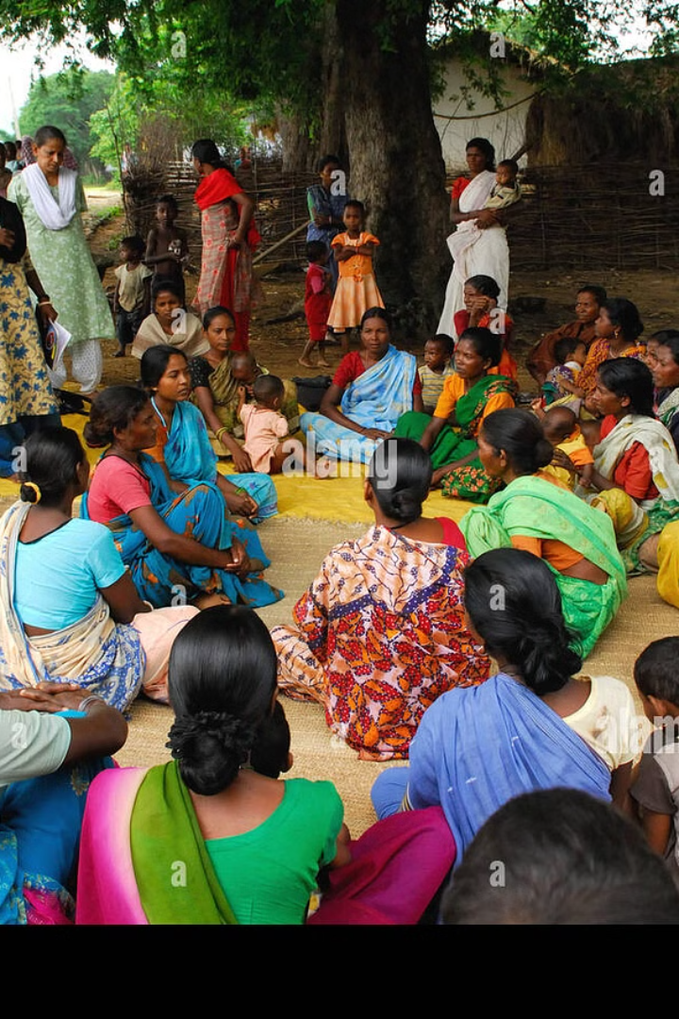

Investigating Professional Education Opportunities for India's Scheduled Tribes
By Sandhya Singh

Slide 2
Introduction
This study delves into the professional education options available to India's Scheduled Tribes (STs) and explores ways to enhance their participation and access to professional education. The Scheduled Tribes have long been one of the most underprivileged and historically marginalized segments of Indian society. Despite numerous programs to support formal education, the literacy rate among the Scheduled Tribes remains low, with the female literacy rate even lower than the national average. It is crucial for children from Scheduled Tribes to receive an education, not only as mandated by the constitution but also as an essential component of their communities' overall development.

Slide 3

Challenges Faced by Scheduled Tribes in Education
1
Low Literacy Rate
2
Geographical Isolation
The literacy rate among the Scheduled Tribes remains significantly lower than the national average, posing a major challenge to their educational development.
Geographical isolation has contributed to the backwardness and limited access to educational resources for the Scheduled Tribes.
3
Economic Exploitation
The Scheduled Tribes face economic exploitation, which further hinders their ability to access quality education.

Slide 4
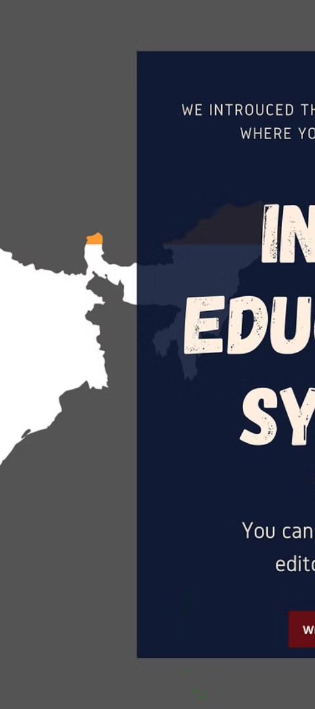
Government Initiatives for Scheduled Tribes' Education
1
Elementary Schools in Tribal Areas
The need for opening elementary schools in tribal areas is recognized and efforts are being made to address this requirement.
2
Educational Programs in Tribal Languages
Efforts are being made to develop educational programs and materials in tribal languages to facilitate learning at the initial stages.
3
Special Scholarships and Training
Special scholarships and training programs are being designed to encourage and support talented Scheduled Tribe students.

Slide 5
Socioeconomic Impact of Educational Interventions
Economic Empowerment
Social Inclusion
Education initiatives have the potential to economically empower the Scheduled Tribes, leading to improved livelihoods and financial stability.
By enhancing access to education, these interventions contribute to the social inclusion of the Scheduled Tribes within the broader society.

Slide 6
Success Stories and Best Practices
Vocational Training Programs
Scholarship Initiatives
Specialized vocational training programs have significantly increased employability and income levels among Scheduled Tribes.
Scholarship programs tailored for ST students have provided crucial financial assistance for higher education in professional domains.

Slide 7
Population Trends of India's Scheduled Tribes
Year
Total Population
ST's Population
Percentage
1981
500
35
7.9
1991
600
40
7.9
2001
785
60
8.5
2011
935
70
9.5

Slide 8
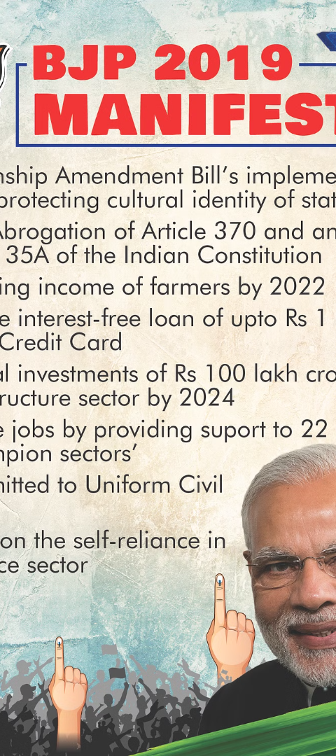
Importance of Focused Policies and Initiatives
1
Socioeconomic Divide
2
Social Inclusion
Focused policies and initiatives are crucial to reduce the socioeconomic divide between the populations of STs and non-STs.
These initiatives are essential for promoting social inclusion, employment, and education among the Scheduled Tribes.

Slide 9
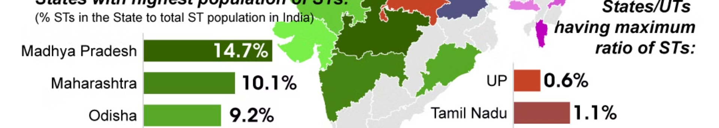



Conclusion
Population Growth
Continuing Significance
Need for Focused Attention
Both the number of STs and India's total population have consistently increased over the years.
The constant percentage of STs in the total population underscores their continuing significance in India's cultural mosaic.
These numbers highlight the need for ongoing focus on the unique requirements and welfare of Scheduled Tribes.

Slide 10
References
Arya, V., Page, A., Dandona, R., Vijayakumar, L., Mayer, P., & Armstrong, G. (2019). The geographic heterogeneity of suicide rates in India by religion, caste, tribe, and other backward classes. Crisis.
Dar, W. A., & Najar, I. A. (2018). Educational anthropology, tribal education and responsible citizenship in India. South Asia Research, 38(3), 327-346.
Devarapalli, S. S. K., Kallakuri, S., Salam, A., & Maulik, P. K. (2020). Mental health research on scheduled tribes in India. Indian Journal of Psychiatry, 62(6), 617-630.
Gulzar, D. (2021). Inclusive Policies and their impact on Tribals of Jammu and Kashmir: A Case of Gujjar Tribals. International Journal of Rural Development, Environment and Health Research, 5(3).
Jain, M., Korzhenevych, A., & Hecht, R. (2021). Two decades of urban and rural restructuring in India: An empirical investigation along Delhi-Mumbai Industrial Corridor. Habitat International, 117, 102444.
Kumar, D., Pratap, B., & Aggarwal, A. (2020). Affirmative action in government jobs in India: Did the job reservation policy benefit disadvantaged groups?. Journal of Asian and African Studies, 55(1), 145-160.
Kumar, R., Mandava, S., & Gopanapalli, V. S. (2019). Vocational training in India: determinants of participation and effect on wages. Empirical Research in Vocational Education and Training, 11(1), 1-17.
Malkani, R., & Rose, R. (2018). Learning from the Voices of First Generation Learners in a Remote Community of Maharashtra, India. International Journal of Whole Schooling, 14(2), 104-127.

