Slide 1

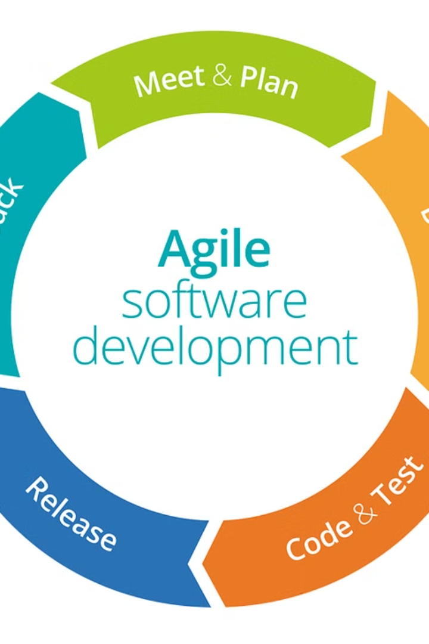

Nimble Approach in Software Engineering
Shailendra Kumar Tiranga
Department of Computer Engineering & Applications Mangalayatan University, Aligarh, Uttar Pradesh (India) sktiranga2412@gmail.com
Dr. Rajeev Yadav
Department of Computer Engineering & Applications Mangalayatan University, Aligarh, Uttar Pradesh (India) rajeev.yadav@mangalayatan.edu.in Profrajeevyadav@gmail.com

Slide 2
Introduction
In the ever-evolving landscape of contemporary software development, the adoption of Agile methodologies has become a hallmark of innovation and efficiency. Agile principles, with their emphasis on iterative development, collaboration, and adaptability to changing requirements, have reshaped how software solutions are conceived, developed, and deployed. As organizations worldwide pivot towards Agile frameworks, the synergy between development and testing practices takes center stage, warranting a profound exploration of testing methodologies within this dynamic context.

Slide 3

Challenges in Agile Testing
1
Rapid Development Iterations
The rapid cadence of development iterations, coupled with evolving user stories and feature requirements, poses a unique set of challenges for testing teams.
2
Testing Strategy Reevaluation
Traditional testing models, reliant on detailed upfront documentation and extensive planning, may struggle to keep pace with the fluidity and unpredictability inherent in Agile projects.
3
Harmonizing with Agile Ethos
This necessitates a reevaluation of testing strategies to harmonize with the Agile ethos.

Slide 4

Functional Testing Dynamics
1
Incremental Development
2
Adapting to Changing User Stories
The emphasis on incremental development and continuous integration demands a shift from conventional, comprehensive test planning to on-the-fly test case creation.
Adapting to changing user stories, ensuring adequate test coverage, and maintaining test consistency in the face of evolving functionalities are focal points demanding exploration within the realm of Agile functional testing.

Slide 5
API Testing Challenges
Evolving APIs
Comprehensive Test Coverage
The dynamic nature of APIs, evolving requirements, and the need for rapid integration necessitate testing approaches that align with the principles of Agile development.
Striking a balance between comprehensive API test coverage and the agility required for continuous integration presents a compelling challenge in this domain.

Slide 6

Database Testing Complexities
Continuous Schema Evolution
Performance and Scalability Considerations
The continuous evolution of database schemas, coupled with the need for rapid data migrations, demands a testing approach that aligns with the pace of Agile development.
Balancing the speed of iterations with comprehensive database testing, including performance and scalability considerations, becomes pivotal for the success of Agile projects.

Slide 7
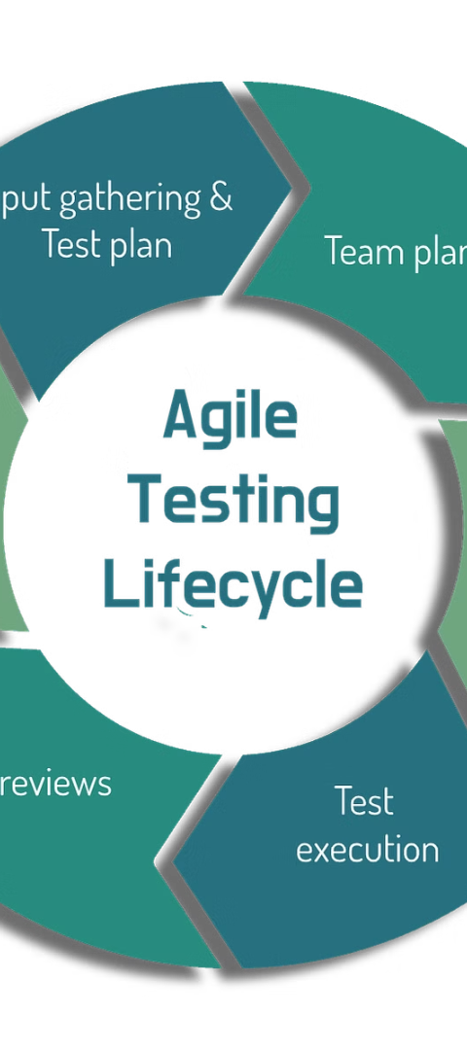
Infrastructure Testing in Agile
1
Dynamic Infrastructure Changes
2
Seamless Integration
Integrating infrastructure testing seamlessly into the Agile development lifecycle demands innovative solutions and a deep understanding of the interplay between software components and underlying infrastructure.
Dynamic infrastructure changes, dependencies on external cloud services, and the need for rapid scalability pose intricate challenges for testing teams.

Slide 8
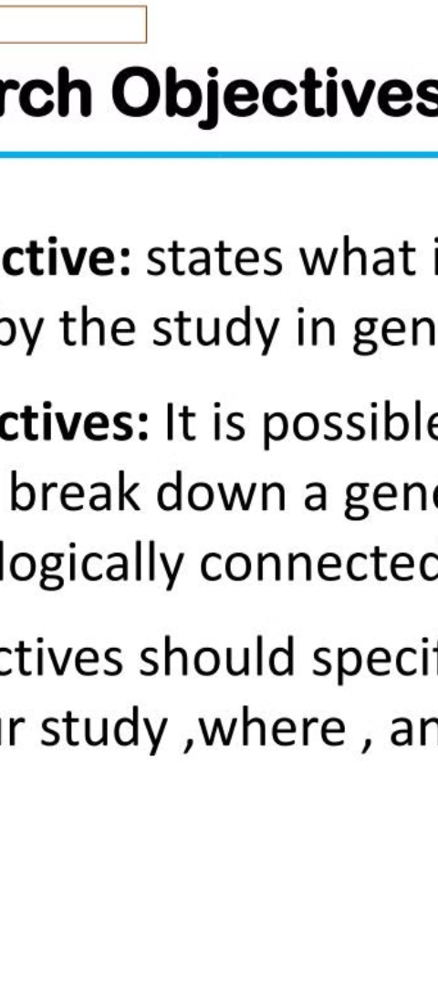
Research Objectives
Exploration of Testing Challenges
Proposing Innovative Solutions
Proposing innovative solutions to enhance testing efficacy by amalgamating empirical data from surveys, interviews, and tool evaluations.
The primary objectives include dissecting the challenges encountered in Functional, API, Database, and Infrastructure testing within Agile contexts.

Slide 9
Methodology
1
2
Research Design
Sampling Strategy
3
4
Data Collection Methods
Literature Review

Slide 10
Conclusion
The comprehensive exploration of testing challenges within Functional, API, Database, and Infrastructure dimensions in Agile methodologies has yielded valuable insights and implications for the software development landscape. The culmination of research findings allows for a conclusive understanding of the challenges, proposed solutions, and the broader impact on Agile testing practices.
In conclusion, this study not only sheds light on the intricacies of testing challenges but also provides a roadmap for organizations to navigate these challenges successfully within the dynamic and iterative landscape of Agile methodologies. The ongoing evolution of Agile testing practices will undoubtedly benefit from the insights gleaned in this research, fostering a culture of continuous improvement in the realm of software development.

Slide 11
References
Pressman, R. S. (2014). Software Engineering: A Practitioner's Approach (8th ed.). McGraw-Hill Education.
Ambler, S. W. (2010). Introduction to Agile Modeling. Agile Modeling. Fowler, M., & Highsmith, J. (2001). The Agile Manifesto. Agile Alliance.
Rajasekaran, M., & Ganesan, L. (2017). Agile Database Techniques: Effective Strategies for the Agile Software Developer. Addison-Wesley.
Kan, S. H. (2003). Metrics and Models in Software Quality Engineering (2nd ed.). Addison-Wesley.
Bass, L., Clements, P., & Kazman, R. (2012). Software Architecture in Practice (3rd ed.). Addison-Wesley.
Babu, B. V. (2015). Agile Software Development: Principles, Patterns, and Practices. Pearson Education.
Sommerville, I. (2011). Software Engineering (9th ed.). Addison-Wesley.
Sandler, C., & Lynn, T. (2018). Software Engineering: A Practitioner's Approach. McGraw-Hill Education.
Ambler, S. W. (2012). An Introduction to Database Testing. Agile Modeling.

