Slide 1
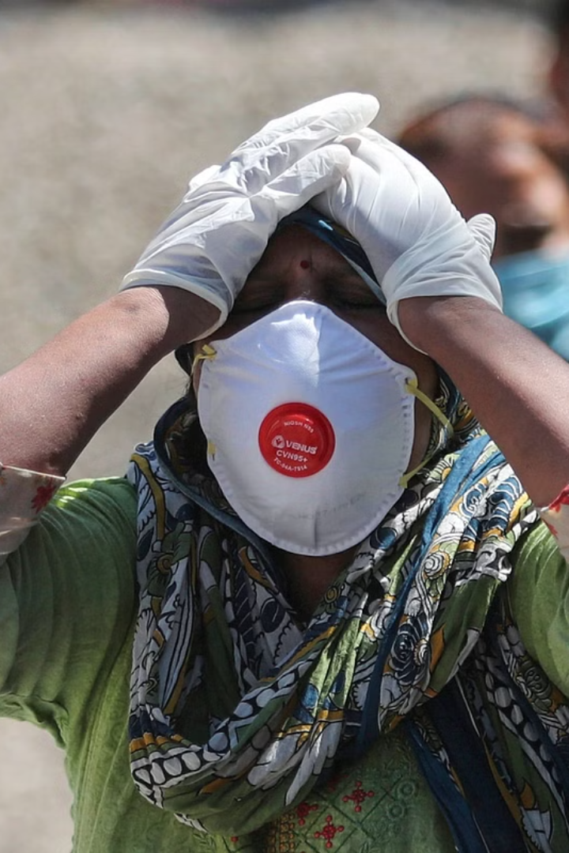

Predictive Modelling and Analysis of Infectious Disease (COVID-19) Cases in Indian States
Manoj Kumar Singh,
Department of Computer Science & Engineering IMS Engineering College Ghaziabad, singhmanojmit@gmail.com
Basudeo Singh Roohani,
Department of Computer Science & Engineering IMS Engineering College Ghaziabad, bsroohani2007@gmail.com

Slide 2
Introduction
India is not an exception to the global impact that the COVID-19 epidemic has had on nations. Given its breadth and diversity, India confronts particular difficulties in the fight against the virus. Although the total number of infections in the nation has received a lot of attention, it is important to focus on particular states and conduct a more detailed analysis of the issue. Due to elements including population density, healthcare infrastructure, and socioeconomic situations, the disease's transmission and effects varied dramatically across different geographical areas. As a result, it is crucial to examine COVID-19 instances in each Indian state independently in order to fully comprehend the problem and provide workable solutions. We analyze data on the number of sick people in each Indian state in this research study with the intention of forecasting the number of illnesses in 2023. We can shed light on the particular issues encountered by various areas by concentrating on state-level analyses and designing actions appropriately. This tailored strategy takes into account India's diversity and makes it possible to implement containment and mitigation measures that are more successful.

Slide 3
Methodology
Data Collection
Data Cleaning
Exploratory Data Analysis (EDA)
The first step involves gathering data on COVID-19 cases in Indian states. Multiple sources can be utilized, including official government websites, health department reports, and reputable databases. The data should encompass relevant variables such as the number of confirmed cases, active cases, recoveries, and deaths for each state over a specified period.
Once the data is collected, it undergoes a thorough cleaning process to ensure its accuracy and consistency. This involves removing any duplicates, correcting errors, addressing missing values, and standardizing the data format across different sources.
The cleaned data is then subjected to EDA techniques to gain insights into the patterns and trends of COVID-19 cases in Indian states. Descriptive statistics, data visualization, and time series analysis can be employed to identify any notable variations in the spread of the virus across different regions.

Slide 4
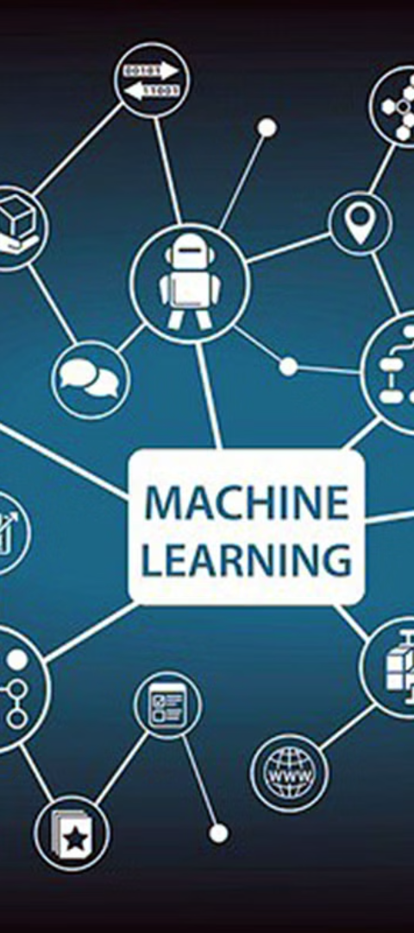
Machine Learning Algorithms
1
Decision Tree Regressor
2
Logistic Regression
The Decision Tree Regressor algorithm is a supervised learning algorithm used for regression tasks. It builds a decision tree based on the provided input features and their corresponding target values.
Logistic regression is a supervised learning algorithm used for classification tasks. While primarily designed for binary classification, it can be extended for multiclass classification.
3
Linear Regression
Linear regression is a supervised learning algorithm used for regression tasks. It models the relationship between the input features and the target variable by fitting a linear equation.

Slide 5
Role of Data Mining and Machine Learning
Identification of patterns and risk factors
Early detection and diagnosis
Contact tracing
Potential transmission channels and hotspots may be identified by analyzing contact tracing data using ML methods. With this information, public health workers may better focus their actions and slow the disease's spread.
Predictive models built using ML may assist detect possible instances of infectious illnesses before they spread. Algorithms may be taught to monitor social media, news broadcasts, and other sources in real time in order to spot signs of impending epidemics.
When it comes to the transmission of infectious illnesses, DM (Data Mining) may be used to assist detect trends and risk factors. ML algorithms can examine massive volumes of data to spot patterns in things like age, pre-existing conditions, and geography that may indicate Corona virus infection.

Slide 6
References
1
A. Kumar, R. K. Sharma, and others (2021)
2
Aduragba, O.T. and Cristea, A.I. (2019)
3
Alfred, R. and Obit, J.H. (2021)
Research on Prediction of Infectious Diseases, their spread via Social Media and their link to Education. In Proceedings of the 4th International Conference on Information and Education Innovations (pp. 38-42).
The roles of ML methods in limiting the spread of deadly diseases: A systematic review. Heliyon, 7(6), p.e07371.
Modelling instances of COVID-19 using machine learning techniques in India. 10(1), 35–43; Health Policy and Technology.

Slide 7

Artificial Intelligence and COVID-19
1
Prediction of the final size for COVID-19 epidemic using ML
A case study of Egypt. Infectious Disease Modelling, 5, pp.622-634.
2
AI-powered cloud for COVID-19 and other infectious disease diagnosis
Personal and Ubiquitous Computing, pp.1-4.

Slide 8



AI and ML in Fighting COVID-19
Prediction
Diagnosis
Cloud Computing
Using ML classification algorithms.
AI for COVID-19 and other infectious disease diagnosis.
AI-powered cloud for COVID-19 diagnosis.

Slide 9



Review of Current Knowledge
COVID-19 in India: A review of current knowledge
Predicting the COVID-19 infection with clinical features using ML
Indian Journal of Medical Research, 151(2), 147-159.
Multimedia Tools and Applications, 80, pp.11943-11957.

