Slide 1
A Critical Review for Job Opportunities and Challenges in Cloud Computing
By:
Neetu Amlani and Dr. Swapnil Deshpande
S.S.Manair College of Computer & Management, Nagpur.

Slide 2

At: Multidisciplinary International Conference,

Slide 3
Abstract
Cloud Computing is an enormously growing field which provides computing services over the internet like servers, storage, networking, analytics etc.
With the trend of shifting from traditional methods to adoption of the latest technology, numerous career opportunities have arisen. There are several areas like Engineering, Security, Architecture, Management etc. which contribute to job prospects there by increasing the employability scale.
Present paper is a review exploring the career development prospects provided by Cloud Computing across different domains.
Keywords: Cloud Computing, Services, Career Opportunities, Job roles.

Slide 4
Introduction
Cloud Computing offers flexible resources which include software, platform or infrastructure in the form of services on the basis of payment as per the usage. With increasing demand for this field, cloud computing has revolutionized the ICT industry too .
  In the field of Business, cloud computing helps in improving the efficacy of the business and also encouraging new transformations.
  The cryptography technology also implements Cloud Computing. Prerequisites for logging in to a cloud computing services are obtainability, unification and confidentiality.
  Real World Applications of cloud computing are E-commerce, Big Data Analytics, software development and IOTs.

Slide 5
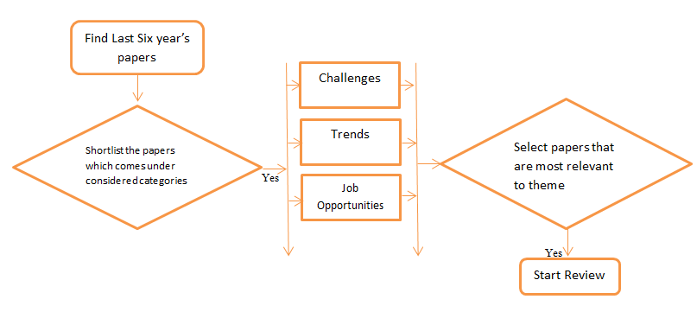
Methodology
Figure 1 shows the workflow for selection

Slide 6
1. Concept of Cloud Computing: With the spread of digitalization, cloud computing has come up as a keystone of modern IT infrastructure. Cloud computing provides flexible and cost-effective solutions for storing, handling, processing and accessing data. There are five types of clouds are Public, Private, Hybrid, community and Multi cloud.
2. Architecture of Cloud Computing: The architecture of cloud computing is categorised into the following two parts-
i. FrontEnd
ii. BackEnd
i. FrontEnd : It refers to the client-side or client-end of Cloud Computing system which includes all applications and user interfaces required to use the cloud computing resources or services.
ii. BackEnd: It means the cloud itself which contains the resources or services along with large storage , network traffic control mechanism , virtual machines and last but not the least deployment models.
Services offered by the cloud can be categorised as follows-
a. IaaS (Infrastructure as a Service): Also referred as Hardware as a service. It delivers massive computing resources like storage capacity, processing and network. Reliability, security and payment as per the usage are the crucial benefits of this service. E.g. AmazonEC2.
b. PaaS (Platform as a Service): This service provides API i.e. Application Program Interface for the cloud. This service provides an environment which is as demanded by the user for developing, testing, delivering and managing the software applications. Eg. Google App Engine.
c. SaaS (Software as a Service): It offers the service which is directly used by the end-user. SaaS is software deployed over the Net. This service aims to replace applications running on a Personal

Slide 7
Advantages of Cloud Computing
Few advantages of cloud computing are:
Data security- Cloud protects the data stored on the cloud from data theft, unauthorized access.
Rapid Application deployment – Cloud computing helps development of new applications with quick deployment.
Cost saving- As the need for expensive hardware, software and maintenance is reduced, cloud computing saves the cost.
Ease of Access from anywhere – Cloud computing provides data access from anywhere and anytime.
Disaster Recovery- Cloud provides backup and recovery and therefore ensures complete data recovery in no time.
Higher Performance – Data centres are updated with latest high-performance technologies which enable better connectivity and high performance.

Slide 8
Work associated with Cloud Computing
As per a report submitted by NASSCOM (National Association of Software and Service Companies), by 2025, the demands for cloud computing skills are anticipated to bloom in Indian IT industry. The field of cloud computing will create more than 2.5 million jobs in India.
This field of cloud computing offers services to enormous fields which include business, education, management, technology etc. Proliferation of services offered by the cloud has boosted the human-computer interaction.

Slide 9
Fig. 2: Cloud Computing Areas with Job Roles
Security
(Security Engg.)
Infrastructure Management
(CI Engg.
(Cloud Infrastructure Engg.)
Cloud Computing Areas with Job Roles.
Technology Solutions
Data Center Hosting
(Data Engg.)
(Cloud Architect)
Service Desk
System Maintenance
(Cloud Consultant)
(Cloud Maintenance
Engg.)

Slide 10
Other opportunities are:
7. DevOps Cloud Engineer: A cloud DevOps engineer is proficient in developing and operating cloud based applications and services.
8. Full Stack Developer: A full stack developer develops both front-end and back-end applications by using the cloud framework.
The management and utilization of computing resources by the organizations has been transformed by cloud computing, which has increased the need for qualified experts to handle its complexity.
To improve user experience and manage upcoming issues, there is an increasing need for personnel with cloud computing competence in addition to technical expertise.

Slide 11
Job Roles to become Cloud Architect
IT Support Specialist → System Engineer → Database Administrator → Database Architect.
Software Developer → Security Engineer → DevOps Engineer → Principal Software Engineer
Cloud Architect
Network Technician → Network Administrator → System Administrator→ Principal System Administrator.

Slide 12
Additional skills required for professionals in field of Cloud are:
Expertise the cloud service platform.
Knowledge of Programming Languages.
Good Command over APIs.
Database Management
Network Management
Fundamentals of Machine Learning
Basics of Artificial Intelligence
Cloud Security

Slide 13
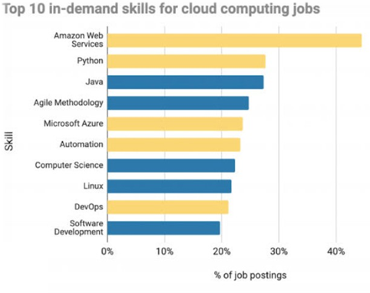
Fig.4: In-Demand Skills for Cloud Computing jobs.(KnowledgeHut)

Slide 14
Conclusion
In this digitalized era, cloud computing has embraced almost all fields because of its services and ease of use and all time availability.
Thus cloud computing unwraps the potential employability. In near future the field of cloud computing is expected to gain deep grounds and thereby offer more job prospects for skilled professionals.
To spread the awareness among the budding IT experts, knowledge of cloud computing must be introduced at early stage in the education system.
Then interested candidates can adopt proper skill channels to enter this field to contribute as potential employees.

Slide 15
Challenges in Job opportunities in Cloud Computing
Working with the cloud can be time consuming due to its complexity and great demand for research. It calls for great deal of subject-matter, knowledge and proficiency.
Despite of large number of experts in this sector, many positions are still vacant as there aren’t many skilled cloud engineers, developers and other specialists.
Up-skilling is required for the experts to actively comprehend and administer and develop cloud based applications with fewest possible problems and highest possible reliability.

Slide 16
Acknowledgment
This review and the research behind it would not have been possible without the exceptional support of Dr. Maneesh Deshpande. His generosity and expertise comments improved this study in innumerable ways and saved us from many blunders; those that inevitably remain are entirely our responsibilities.
We are also grateful to our Head of the Department, M.Sc. IT , Dr. Diwakar Tripathi, for his kind support, guidance and co-operation throughout the work.

Slide 17
References
Amanpreet Kaur, V.P. Singh, Sukhpal Singh Gill, “The Future of Cloud Computing: Opportunities, Challenges and Research Trends”, 2nd International Conference on I-SMAC (IoT in Social, Mobile, Analytics and Cloud), DOI: 10.1109/I-SMAC.2018.8653731, 2018.
Amir Taherkordi, Feroz Zahid, Yiannis Verginadis, and Geir Horn, “Future Cloud Systems Design: Challenges and Research Directions”, IEEE Access, Volume: 6, DOI: 10.1109/ACCESS.2018.2883149, pp. 74120 – 74150, November 2018.
Stephen, A. Arul Anitha, L. Arockiam, “Cloud Computing: Opportunities and Challenges”, ReTeLL, Vol. 21, June 2019.
Blesson Varghese, Rajkumar Buyya, “Next Generation Cloud Computing: New Trends and Research Directions”, Future Generation Computer Systems, doi.org/10.1016/j.future.2017.09.020, Volume 79, Part 3, pp. 849-861, February 2018.
Colin Ting Si Xue, Felicia Tiong Wee Xin, “Benefits and Challenges of the Adoption of Cloud Computing in Business”, International Journal on Cloud Computing: Services and Architecture (IJCCSA) Vol. 6, No. 6, December 2016.
Dibyendu Mahato, Dr. Ajay Jain, “Discussing the Challenges and Future Trends of Cloud Computing”, International Journal of Mechanical Engineering, DOI: https://doi.org/10.56452/7-12-34, Vol. 7 No. 12, December 2022.
Hazzaa N. Alshareef, “Current Development, Challenges and Future Trends in Cloud Computing: A Survey”, (IJACSA) International Journal of Advanced Computer Science and Applications, Vol. 14, No. 3, 2023.
Matthew N.O. Sadiku, Sarhan M. Musa, and OMonowo d. Momoh, “Cloud computing: Opportunities and challenges”, IEEE Potentials, Volume: 33, Issue: 1, pp. 34 - 36 Jan.-Feb. 2014.
Majed Balkhi, “Opportunities of Cloud Computing”, International Journal of Innovation and Scientific Research, Vol. 4 No. 1, pp. 33-41, Jul. 2014.
Mbasa Joaquim Molo, Joke A. Badejo, Emmanue Adetiba, Vingi Patrick Nzanzu, Etinosa Noma-Osaghae, “A Review of Evolutionary Trends in Cloud Computing and Applications to the Healthcare Ecosystem”, Applied Computational Intelligence and Soft Computing, Article ID 1843671, doi.org/10.1155/2021/1843671, 2021.
Nasser Taleb, Elfadil A. Mohamed, “Cloud Computing Trends: A Literature Review”, Academic Journal of Interdisciplinary Studies, Doi: 10.36941/ajis-2020-0008, Vol 9 No 1, January 2020.
Ozcan Ozyurt, Fatih Gurcan, Gonca Gokce Menekse Dalveren and Mohammad Derawi, “Career in Cloud Computing: Exploratory Analysis of In-Demand Competency Areas and Skill Sets”, Applied Sciences, https://doi.org/10.3390/app12199787, volume 12, Issue 19, 2022.
Prantosh Kumar Paul, Mrinal K. Ghose, “Cloud Computing: Possibilities, Challenges and Opportunities with Special Reference to its Emerging Need in the Academic and Working Area of Information Science”, Procedia Engineering, Volume 38, pp. 2222-2227, 2012.
Prince Kwame Senyo, Erasmus Addae, Richard Boateng, “Cloud Computing Research: A Review of Research Themes, Frameworks, Methods and Future Research Directions”, International Journal of Information Management, Volume 38, Issue 1, pp. 128-139, February 2018,
Rafia Islam, Vishnu Vardhan Patamsetti, Aparna Gadhi, Ragha Madhavi Gondu, Chinna Manikanta Bandaru, Sai Chaitanya Kesani, Olatunde Abiona, “The Future of Cloud Computing: Benefits and Challenges”, Int. J. Communications, Network and System Sciences, doi.org/10.4236/ijcns.2023.164004, 2023.
Sameer A. Nooh, “Cloud Cryptography: User End Encryption”, International Conference on Computing and Information Technology, Volume: 01, Issue: ICCIT- 1441, pp. 397 - 400, 9th & 10th Sep. 2020.
Seema Pathak, Anil Kumar Tiwari, Khirodra Bhoi, “Cloud Computing: New Trends and Research challenges”, Research Journal of Engineering and Technology, DOI: 10.5958/2321-581X.2020.00013.6, Vol 11, issue 2, April- June, 2020.
Siraj Munir, Syed Imran Jam, “Current trends in cloud computing”, Indian Journal of Science and Technology, doi.org/10.17485/IJST/v13i24.358, 13(24): pp. 2418-2435, 2020.
Jamsheela O., Mohd Abdul Hameed, “Recent Trends in Cloud Computing”, International Journal of Computer Sciences and Engineering, vol.7, issue5, doi.org/10.26438/ijcse/v7i5.18461851, pp.1846-1851, May 2019.

Slide 18
Thank You.

