Slide 1
"THE EVOLUTION OF CYBER THREATS: A DEEP DIVE INTO EMERGING ATTACK VECTORS, MITIGATION TECHNIQUES, AND FUTURE FORECASTING FOR ROBUST CYBER DEFENCE STRATEGIES"
Dr. Abdul Khadeer, Assistant Professor
Dept. of Computer Science Engineering
Deccan College of Engineering and Technology, Hyderabad, Telangana, India

Slide 2
ABSTRACT
The rapid evolution of technology has brought about a corresponding evolution in cyber threats, presenting a constant challenge for cybersecurity professionals. This paper provides a comprehensive examination of the evolving landscape of cyber threats, focusing on emerging attack vectors, effective mitigation techniques, and strategies for future forecasting to fortify cyber defence mechanisms. First, it explores the proliferation of novel attack vectors, including advanced persistent threats (APTs), ransomware, supply chain attacks, and insider threats. By dissecting the methodologies and tactics employed by cyber adversaries, this paper elucidates the multifaceted nature of contemporary cyber-attacks. Second, it delves into the arsenal of mitigation techniques available to thwart these evolving threats. From traditional methods such as firewalls and antivirus software to cutting-edge technologies like artificial intelligence and machine learning, various approaches are evaluated for their efficacy in safeguarding against cyber intrusions. This paper investigates the importance of proactive measures in anticipating future threats and formulating robust cyber defence strategies. By analysing current trends and extrapolating potential trajectories, organizations can pre-emptively adapt their security posture to mitigate risks effectively. This paper underscores the critical need for continuous adaptation and innovation in the realm of cybersecurity. By staying abreast of emerging threats, leveraging advanced technologies, and adopting a forward-thinking approach, organizations can enhance their resilience against evolving cyber adversaries and ensure the integrity of their digital infrastructure.

Slide 3
INTRODUCTION
In the contemporary digital landscape, the evolution of cyber threats presents a formidable challenge to individuals, organizations, and nations alike. As technology advances, so too do the methods and capabilities of malicious actors seeking to exploit vulnerabilities for their own gain. Understanding the dynamic nature of cyber threats is paramount for developing effective defence strategies that can withstand the ever-changing tactics of adversaries.
This paper delves into the intricate world of cyber threats, offering a comprehensive examination of emerging attack vectors, innovative mitigation techniques, and insightful future forecasting to fortify cyber defence strategies. By dissecting the evolving nature of cyber threats, we aim to equip stakeholders with the knowledge and tools necessary to adapt and respond proactively to emerging challenges.
Through a synthesis of current research, real-world case studies, and expert analysis, this paper seeks to provide a comprehensive framework for understanding and addressing the evolving nature of cyber threats. By examining emerging attack vectors, exploring innovative mitigation techniques, and forecasting future trends, we aim to empower stakeholders with the insights necessary to develop robust and resilient cyber defence strategies in an increasingly complex digital environment.

Slide 4
EVOLUTION OF CYBER THREATS
Historical Overview: This section offers insights into the historical progression of cyber threats, tracing their origins from early viruses and worms to sophisticated cyber-attacks.
Emerging Attack Vectors: Exploring the latest tactics employed by cybercriminals, including ransomware, phishing, supply chain attacks, and zero-day exploits.
Mitigation Techniques: This segment delves into contemporary approaches and tools for mitigating cyber threats, encompassing strategies such as network segmentation, encryption, multi-factor authentication, and behaviour-based anomaly detection.
Future Forecasting: Anticipating potential future cyber threats based on current trends and technological advancements.
Robust Cyber Defence Strategies: Providing practical recommendations for organizations to bolster their cyber defence posture, encompassing initiatives such as comprehensive employee training programs, threat intelligence sharing partnerships, incident response readiness, and continuous security assessments.

Slide 5
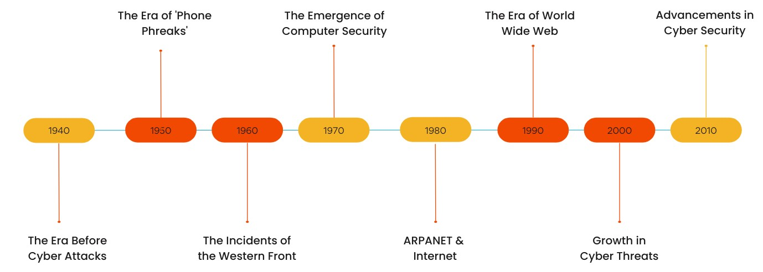
CYBER SECURITY HISTORY TIMELINE

Slide 6
MODERN CYBER THREAT LANDSCAPE
The modern cyber threat landscape is dynamic, with cybercriminals continuously evolving their tactics to exploit vulnerabilities in systems and networks.
Attack vectors such as ransomware, phishing, and social engineering are becoming increasingly sophisticated, targeting individuals, businesses, and even critical infrastructure.
Moreover, the proliferation of Internet of Things (IoT) devices has expanded the attack surface, allowing malicious actors to harness insecure devices for large-scale attacks.
To address these challenges, organizations must employ a multifaceted approach that includes robust threat intelligence, proactive risk management, and advanced technologies like artificial intelligence and machine learning for threat detection and response.
Looking ahead, the future of cybersecurity will likely be shaped by emerging technologies and evolving threat landscapes, underscoring the importance of continuous adaptation and innovation in cyber defence strategies.

Slide 7
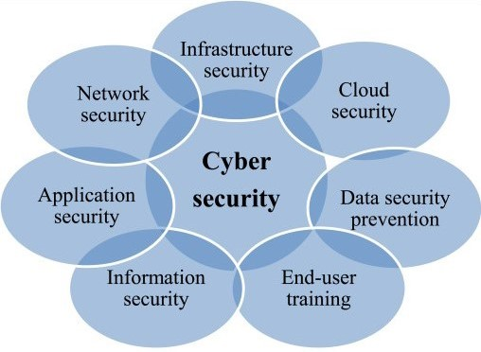
STRATEGIES OF CYBER SECURITY

Slide 8
EMERGING ATTACK VECTORS
Social Engineering Tactics: Attackers exploit human psychology through phishing, vishing, and smishing to gain unauthorized access to systems and data.
Internet of Things (IoT) Vulnerabilities: The proliferation of IoT devices introduces new entry points for cyber-attacks, including device hijacking and data interception.
AI and Machine Learning Exploitation: Attackers leverage AI and machine learning algorithms to automate attacks, evade detection, and enhance targeting precision.
Supply Chain Attacks: Targeting third-party vendors and suppliers, attackers compromise software and hardware components to infiltrate interconnected systems.
Quantum Computing Threats: The advent of quantum computing poses a significant risk to current encryption standards, potentially rendering traditional cryptographic protocols obsolete.
Zero-Day Exploits: Exploiting undisclosed vulnerabilities, zero-day attacks can inflict significant damage before patches are developed.
Ransomware-as-a-Service (RaaS): RaaS platforms enable less technically proficient actors to launch ransomware attacks, increasing their prevalence and sophistication.
Blockchain Security Concerns: While blockchain offers robustness in some areas, vulnerabilities in smart contracts and decentralized applications present new attack vectors.

Slide 9
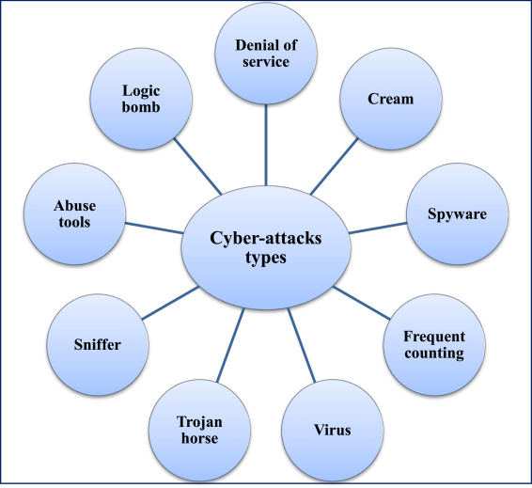
TYPES OF CYBER ATTACKS

Slide 10
MITIGATION TECHNIQUES
User Education and Awareness
Patch Management
Network Segmentation
Implementing Multi-Factor Authentication (MFA)
Incident Response Planning
Threat Intelligence Integration

Slide 11
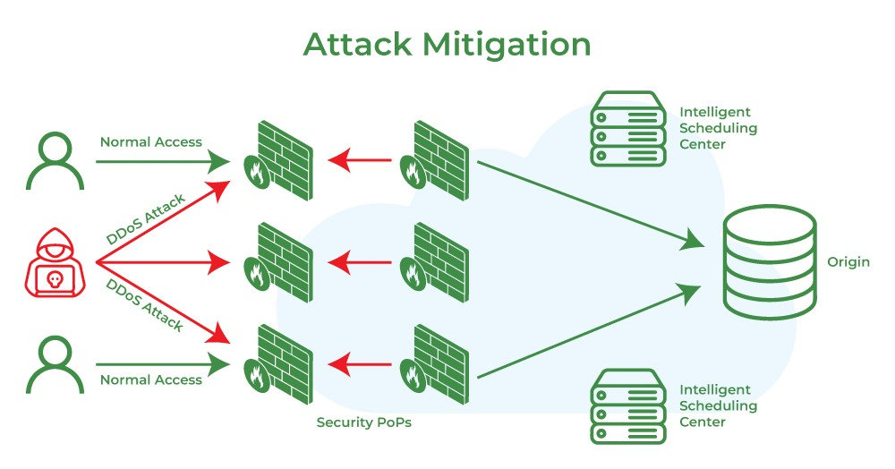
ATTACK MITIGATION

Slide 12
FUTURE FORECASTING AND TRENDS
AI-Powered Attacks
IoT Vulnerabilities
Supply Chain Attacks
Quantum Computing Risks and Defences
Ransomware-as-a-Service (RaaS)

Slide 13
CONCLUSION
"The Evolution of Cyber Threats" provides a thorough exploration of the rapidly changing landscape of cyber threats, offering insights into emerging attack vectors, effective mitigation techniques, and future forecasting for robust cyber defence strategies.
By delving into the intricacies of evolving tactics employed by malicious entities, the text underscores the critical need for proactive measures to counter these threats effectively.
It emphasizes the importance of leveraging advanced technologies, fostering collaboration among stakeholders, and promoting a culture of cybersecurity awareness to stay ahead of evolving threats.
Furthermore, the text highlights the significance of continuous adaptation and innovation in cybersecurity practices, stressing the importance of ongoing education, research, and strategic planning.
By embracing these principles and adopting a holistic approach to cyber defence, organizations can enhance their resilience and effectively safeguard their digital assets against ever-evolving cyber threats, ensuring the integrity and security of global networks.

Slide 14
REFERENCES
Anderson, R., & Moore, T. (2006). The economics of information security. Science, 314(5799), 610-613.
Scarfone, K., & Mell, P. (2007). Guide to intrusion detection and prevention systems (IDPS). National Institute of Standards and Technology (NIST), Special Publication, 800(94).
Duan, X., Gu, G., & Yin, H. (2012). A survey on sensor-based threat detection in cyber–physical systems. IEEE Communications Surveys & Tutorials, 15(1), 22-36.
Cavusoglu, H., Mishra, B., & Raghunathan, S. (2004). The effect of internet security breach announcements on market value: Capital market reactions for breached firms and internet security developers. International Journal of Electronic Commerce, 9(1), 70-104.
Goel, S., & Bushnell, L. (2012). Cyber–physical security of a smart grid infrastructure. Proceedings of the IEEE, 100(Special Centennial Issue), 210-224.
Stock, J. H., & Watson, M. W. (2003). Introduction to econometrics (Vol. 2). Boston: Addison Wesley.
Moore, T., Clayton, R., Anderson, R., & Stern, H. (2009). The economics of online crime. Journal of Economic Perspectives, 23(3), 3-20.
Kshetri, N. (2007). Cybercrime and developing nations: Challenges and cases. Hershey, PA: IGI Global.
Roman, R., Zhou, J., & Lopez, J. (2013). On the features and challenges of security and privacy in distributed internet of things. Computer Networks, 57(10), 2266-2279.
Scarfone, K., & Souppaya, M. (2013). Guide to enterprise telework, remote access, and bring your own device (BYOD) security. National Institute of Standards and Technology (NIST), Special Publication, 800(114).
Ransbotham, S., Mitra, S., & Ramsey, J. (2009). Measuring the security risk of software vulnerabilities: A case study of the MITRE corporation. Information Systems Research, 20(1), 132-151.
Kshetri, N. (2010). Global perspectives on e-commerce taxation law. Hershey, PA: IGI Global.
Yang, Y., Zhang, Q., & Zhong, Y. (2013). Cloud computing research and development trend. Journal of Cloud Computing: Advances, Systems and Applications, 2(1), 10.
Kabir, M. N., Hasan, R., Ahamed, S. I., & Rafi, M. M. (2012). Cyber security in the cloud: A survey. Proceedings of the International Conference on Advances in Computing, Communications and Informatics (ICACCI), Chennai, India (pp. 156-161).
Kannan, K. N., & Ganesh, P. K. (2012). Cyber warfare: An analysis of the means and motives of selected nations. International Journal of Cyber Warfare and Terrorism (IJCWT), 2(4), 44-58.
Krishna, A., & Sahasrabudhe, M. (2013). The internet of things: A survey. International Journal of Computer Science and Information Technologies, 4(5), 612-615.
Ristenpart, T., Tromer, E., Shacham, H., & Savage, S. (2009). Hey, you, get off of my cloud: Exploring information leakage in third-party compute clouds. Proceedings of the 16th ACM Conference on Computer and Communications Security, Chicago, Illinois, USA (pp. 199-212).

