Slide 1
STRATEGIC PLANNING AND LEADERSHIP IMPACT IN AUTOMOBILE SECTOR
Rajesh Kumar Acharya
Subject: Commerce & Management

Slide 2
INTRODUCTION
In a period of veritable overall monetary disturbance, automakers should be ready to conform to unanticipated natural movements. This guidance may just cover innovation and gear and be discretionary.
Supervisors and significant work force should likewise think imaginatively, in an unexpected way, and concurrently to explore this shift.
Accordingly, authoritative leadership works with the securing of vital abilities and worth.
Long haul direction is expected for vital preparation to change in accordance with moving business conditions and other functionally influencing factors.
Organizations that enjoy a serious benefit can beat their rivals by controlling expenses and giving unmistakable items that enticement for clients.
Key arranging advances client maintenance, attracts new business, and encourages positive associations. An ideal impression of the item creates more deals and improved results.

Slide 3
LITERATURE REVIEW
Majeed (2011) said that an organization's piece of the pie influences how well it performs. This is on the grounds that it decides their imminent deals level in view of the quantity of clients that show interest in their items.
According to research by Mwangi (2008), An organization's upper hand hugely affects its portion of the overall industry. Separation, a part of upper hand, supports serious valuing, expanded result, and showcasing correspondence. These elements have an immediate connection with execution.
According to a Nyaema (2017) research, The automobile business should continuously be cutthroat in the arrangement of administrations assuming it is to thrive and stay significant in the commercial center.
Muchiri (2014) intended to determine the serious strategies used by Kenyan auto part makers. Their utilization of concentration, separation, and cost leadership strategies was shown by the discoveries. These strategies fundamentally worked on their exhibition.

Slide 4
RESEARCH METHODOLOGY
Both subjective and quantitative methodologies were utilized in the multi-strategy study's information assortment and examination.
More industry experts were reviewed as a component of quantitative allots to find how vital preparation and development are connected.
100 chiefs, supervisors, and representatives in the auto business partook in the survey.
Respondents with relevant information and points of view on industry advancement and vital direction were chosen using deliberate inspecting.
The total comprehension of the exploration difficulties and ideas for further developed key navigation and auto advancement were made conceivable by the information incorporation.
Worries about morals were tended to by informed assent and secrecy. Member accessibility and the review's pertinence to the car business were its primary limitations.

Slide 5
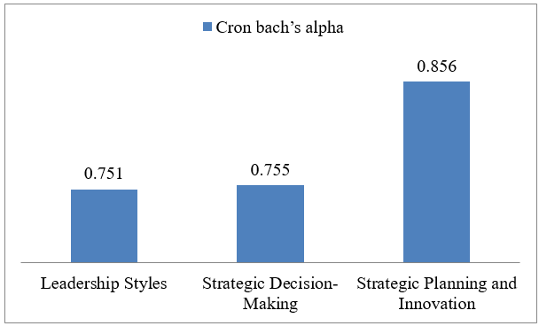
Reliability Statistics
DATA ANALYSIS
The dependability statistics display the internal consistency of each variable's items. The cronbach's alpha value for leadership styles is 0.751, suggesting a moderate level of internal consistency among the five components. This implies that the items measuring leadership style are reliable and measure a similar construct. The cronbach's alpha coefficient for strategic decision-making is 0.755, indicating a reasonable level of internal consistency across the five items. It seems that components of strategic decision-making are also trustworthy. With a higher cronbach's alpha coefficient of 0.856, strategic planning and innovation were shown to have greater internal consistency across the five components.

Slide 6
CONCLUSION
The study looked at innovation, strategic planning, leadership philosophies, and strategic decision-making in the automotive sector. The results highlight the complexity of leadership and decision-making in promoting industrial innovation by demonstrating significant correlations between leadership styles and decision-making methodologies. Innovation was fueled by transformational leadership, which was also associated with data-driven, collaborative, and servant leadership, as well as innovation strategy. These findings suggest that automakers may be more innovative if transformational leadership and other supportive styles and tactics are used.

Slide 7
REFERENCES
Johnson, G., Scholes, K., & Whittington, D. (2008). Exploring corporate strategy. Pearson Education.
Mwaura, J. N. (2013). The influence of government policies on the performance of manufacturing firms in Kenya. Unpublished master's thesis, University of Nairobi, Kenya.
Ogolla, G. O. (2013). The influence of strategic planning on the performance of manufacturing firms in Kenya. Unpublished master's thesis, Jomo Kenyatta University of Agriculture and Technology, Kenya
B.T. Hayati's (2019) work on technology transfer in business can be accessed on the website SlideShare, available at http://www.slideshare.net/nabilahnajah/.
Tobin, J. (2020). Can We Grow Faster? Cowles Foundation Discussion Papers, no. 1149. Available at: http://cowles.yale.edu/sites/default/files/files/pub/d11/d1149.pdf

Slide 8
Thank you

