Slide 1
IMPLEMENTATION OF ALGEBRIC EXPRESSIONS IN AI AND ITS SUPPORTIVE ANALYTICS
Mahendra Kumar Mohapatra
Subject: Mathematics

Slide 2
INTRODUCTION
All scholarly levels have seen an undeniable development in PC use in schooling throughout the course of recent years because of the need of coordinating innovation into the educating learning process.
Educational materials that improve and uphold the learning climate both inside and beyond the homeroom are among its applications.
The software engineers then, at that point, investigate various procedures for creating advanced materials that can be utilized during the informative cycle.
Probably the most generally involved approaches for making educational programming incorporate creating devices like Chief, Streak, and Toolbook, to specify a couple; conventional programming dialects like Java and C++; and some Artificial Intelligence (AI) procedures like Information Based Systems.
Intelligent Tutoring Systems (ITS), which incorporate a counsel who coordinates students' learning and suggests the ideal game-plan, are the consequence of broad exertion.

Slide 3
LITERATURE REVIEW
The improvement of different data, correspondence, and processing advancements has opened up additional opportunities for further developing educating and learning; (Zawacki-Richter et al., 2019).
(Tang et al., 2021) reached the resolution that AI has been applied in various application regions, most outstandingly software engineering, science, innovation, designing, and math, in the wake of assessing the AIED in advanced education distributions distributed somewhere in the range of 2007 and 2018.
Analysts have shown that, in the twenty-first 100 years, showing students higher request thinking abilities, critical thinking, and imaginative reasoning is similarly all around as significant as showing them information (Rau et al., 2017).
To further develop learning results, one review (Bano et al., 2018) utilized a hereditary calculation to build a modified e-learning system that would propose an educational plan succession to every student separately.

Slide 4
EDUCATIONAL SYSTEM FOR THE EDUCATION OF ALGEBRA
Numerical language, factorization, destructions, monomial and polynomial tasks, critical items, and algebraic part activities are completely shown in the KB schooling system.
The four modules that make up the polynomial math showing system are Practice, Conference, Training, and Assessment.
Clients can peruse subjects connected with the school system in the Meeting work mode.
With a partaking student (client) and a teacher (system), intelligent work mode recreates a homeroom setting.
In light of the reactions, the system figures out what to explain and how a lot. Then, exclusively address the region of the topic that the student sees as troublesome.
This hypermedia empowers clients to evaluate theoretical issues that surface on a regular premise since route is client coordinated and digresses from foreordained advances.
Through activities and arrangements, you might try every one of the ideas in the Training region.

Slide 5
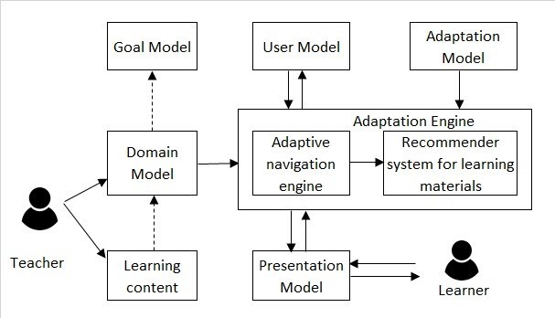
ARCHITECTURE OF THIS ADAPTIVE TRAINING METHOD
ADAPTIVE CONTROL SYSTEM
The design of this adaptive training approach is shown in Figure 1. The method comprises two databases, a knowledge base with the algebra teaching system, and communication techniques built in C++. It is possible to adapt instruction to students' development by using two databases. The student model database keeps track of every interaction between students. Students choose exercises from a database of exercises categorized by level of complexity, which is determined by the lecturer. Data from student models is used in performance reports and statistical analyses. But since a KB is being used, the system can infer that the student's method of learning is inappropriate.

Slide 6
CONCLUSION
For the purpose of teaching mathematics, an adaptive control system offers students a flexible and customized learning experience.
By keeping track of how students engage with one another and adjusting the exercises' intrinsic difficulty, the technology ensures that every student can learn at their own pace.
The system's design—which incorporates databases, a knowledge base, and communication mechanisms—allows for effective adaptation to student development.
The system's total effectiveness is influenced by both the statistical information it provides and its ability to deduce learning strategies.
All things considered, using technology to drive customization and flexibility in algebra instruction, the adaptive control system is a promising approach.

Slide 7
REFERENCES
Hwang, G.J., Hung, P.H., Chen, N.S., & Liu, G.Z. (2014). Mindtool-assisted in-field learning (MAIL): An advanced ubiquitous learning project in Taiwan. Educational Technology & Society, 17, 4–16.
Zawacki-Richter, O., Marín, V.I., Bond, M., & Gouverneur, F. (2019). Systematic review of research on artificial intelligence applications in higher education–where are the educators? International Journal of Educational Technology in Higher Education, 16, 1–27.
Demir, S., & Basol, G. (2014). Effectiveness of Computer-Assisted Mathematics Education (CAME) over Academic Achievement: A Meta-Analysis Study. Educational Sciences: Theory & Practice, 14, 2026–2035.
Bano, M., Zowghi, D., Kearney, M., Schuck, S., & Aubusson, P. (2018). Mobile learning for science and mathematics school education: A systematic review of empirical evidence. Computers & Education, 121, 30–58.
Hershcovits, H., Vilenchik, D., & Gal, K. (2019). Modeling engagement in self-directed learning systems using principal component analysis. IEEE Transactions on Learning Technologies, 13, 164–171.

Slide 8
THANK YOU

